Slide 2
Sponsored by
as mandated by

Slide 3
Ohio
Pole Vault Safety Clinic
2016
www.watkinstrack.org

Slide 4
Want a copy of this??
www.watkinstrack.org
Both this slide presentation and a paper copy of the notes are available on this website --- or for us “old schoolers”
Take notes if you’d like!!!!

Slide 5
Goals of the Clinic
- to show a systematic progression method of teaching pole vault which develops safe vaulting habits
- to acquaint coaches and athletes with the basic theories of pole vault
- to make participants aware of the current problems with pole vaulting in Ohio and US
- to demonstrate examples of good pole vault drills and techniques

Slide 6
Developed by:
Marty Dahlman, Track Coach, Watkins Memorial High School
BA Denison University, MEd Ashland University
Ohio Pole Vault Safety Committee OAT-CCC
Men’s Pole Vault Coach - Team Ohio, Midwest Meet of Champions (2009 - 11)
Pole Vault Director, TAD Sports, Granville, O\hio
ASTM Pole Vault Sub-Committee member
Best Vaulters (from Watkins)
Kyle Burns 15-4 Pat Walton 14-6
David Hill 15-3 Scott Haden 14-6
Mike Huston 15-0 Chris Koon 14-4
Troy Rhoades 14-3
Sammi Miller 10-7 Doug Payne 14-0
Rebeccas Ollish 10-6 Chris Dennis 14-0
Michelle Robbins 10-6 Dusty Rhoades 14-0
Rachel Arnott 10-6 Wayne Ratliff 14-0
Taylor Amrine 10-6 Austin Jackson 14-0
Cameron Johnson 14-0
Mitchell Novotni 14-0
        Jarod Worcester 14-0

Slide 7
Pole Vault in Ohio
The GOOD!!!!!
- NO catastrophic accidents in Midwest last year
- more participation across the state - particularly in girls competition
- great state meet competition in all classes
- more consistently SAFE coaching

Slide 8
Pole Vault in Ohio
        The Not So Good
changes in pit regulations have cost a lot of money
Confusion about future pit and safety rules causing
concerns
some schools have dropped vault rather than make the changes
some coaches/schools are practicing on illegal facilities - risking liability if an accident occurs

Slide 9
Pole Vault in Ohio
        The Bad
the memory of prior catastrophic accidents is still fresh - and of great concern
some coaches are still in the “bend big - vault high” mode (vaulting on poles rated below the vaulter’s weight or moving them onto longer poles before the vaulter is prepared), risking injury to vaulters
lots of misinformation about pole vault is still “out there”
(example: pole vaulting increases the liability insurance that schools pay for athletics. In fact - the insurance schools buys is for all sports coverage. For a six day pole vault camp with full liability coverage, and personal injury
insurance for staff and vaulters totaling 100 people - only
$350)

Slide 10
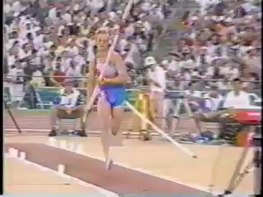

Slide 11
Pole Vault
Physics
and
Methods

Slide 12
Physics and Methods
Goal: to store energy in the pole and be in the appropriate position to get it back
Goal: PENETRATION into the pit - THEN height over the bar
Note: Items which are SAFETY ISSUES are highlighted in RED!!

Slide 13
Physics and Methods
Pole Run -
goals:
  to have the optimum amount of energy at the plant
  to set up for a perfect plant
  to have a repeatable sequence that can be adjusted for conditions
Factors in the Pole Run
- speed at plant
- alignment of body and pole to runway
- positioning of body during run to setup plant position

Slide 14
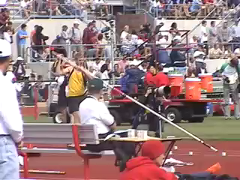

Slide 15
Pole Carry
Pole Grip
set top hand height (depending on vault penetration (see pole selection)
top hand faces out (away from body)
bottom hand goes elbow length away (plus or minus)
bottom hand faces in (towards body)
Right Angles
top hand goes above hip (hand relaxed) right arm at 90º angle
left arm forms two 90º angles - in the armpit and at the elbow
pole tip should be above eye level (higher for longer poles)
shoulders should be square to the runway
perpendicular to the line of travel
left wrist should be bent so hand is above wrist allowing left palm to “face” the pole

Slide 16
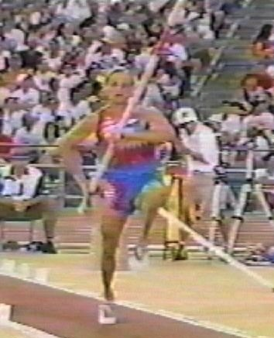
Terasov:
Pole held by top hand
Behind and above hip
Right arm at right angle
Left arm at right angle
both at elbow and
shoulder
Erect Posture - high knees

Slide 17
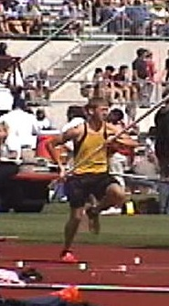
Burns:
Right hand behind and above
hip
Right arm at right angle
Left arm and shoulder at right
angle
Erect Posture - high knees
(note slight lean as this is his
first step)

Slide 18
Pole Run
Goals:
pole run should be a smooth transition with a steady acceleration from the start to “optimum” vault speed
optimum speed is as fast as a vaulter can go AND execute an
accurate run and effective plant (not out of control MAXIMUM!!)
pole run should end at optimum speed for plant
  pole run should be repeatable and consistent

Slide 19
COUNTING!!!
consistent run - counting system
counting system insures a repeatable rhythm
vaulters will start at a 6 or 7 “left” approach - as they improve
in skill they may move up to 8 or 9 lefts
collegians and world class vaulters may use 10 lefts
a seven step approach using three’s would go:
3-2-1, 3-2-1, flat flat (increasing in tempo through the 3’s)
an eight step approach using three’s would go:
1, 3-2-1, 3-2-1, flat flat
(increasing in tempo through the 3’s)

Slide 20
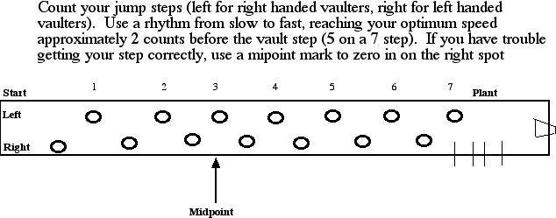
Counting on Runway

Slide 21
Counting on Runway
the “flat flat” is the last right/left -
emphasis on a quick step to increase the jumping tempo (penultimate step)
note - using 3-2-1’s instead of counting up (1-7) allows additional steps to be added without changing the planting rhythm and count

Slide 22
Pole Carry and Drop
pole should gradually drop to the plant - higher carry is better
run should be tall - knees should be up - body position should be as vertical as possible
pole should be held in a relaxed manner - but pole should be steady
no forward and back action (shuttling) - a little up and down is OK

Slide 23
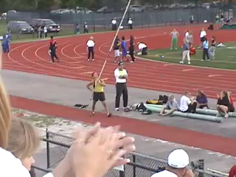
Austin went to state this year – he wanted a rhythm so
We gave him “the clap”!!!!

Slide 24
Pole Carry and Run Drills
Pole Carry Drills
  - stubby drills - standing carry, buddy check of angles
Pole Run Drills
- with stubbies - stubby walks - counting walks - counting - jogs - counting runs - same with poles
- pole runs for steps - marking starting position - plant step (midpoint?)
- towel plants
  “free drop drills (to feel how long the pole takes to free drop to box)

Slide 25
THE PLANT
The PLANT - (the most important part of the event)
the plant is where the energy developed in the run gets stored in the pole
the plant is where horizontal energy gets turned into vertical energy
the plant is where energy is stored not only in the pole, but in the body
random energy stored improperly in the body is a major cause of injury (ex: consistent “under plants” create lower
back injuries)

Slide 26
Mechanics of the perfect plant
pole is directly overhead (not to either side)
pole is mid to slightly behind mid-head
right arm is fully extended (“pressed up”)
left arm is fully extended (“pressed up” - short pole exception)
head - shoulders - hips are all raised (“pressed up”)
Shoulders are “square” to pit and runway
plant toe is directly under right hand
right leg is “stepped out” to 90° - right toe is up
chest is driving forward ahead of hips
“jump” is like long jump takeoff - approximately 22 degrees

Slide 27
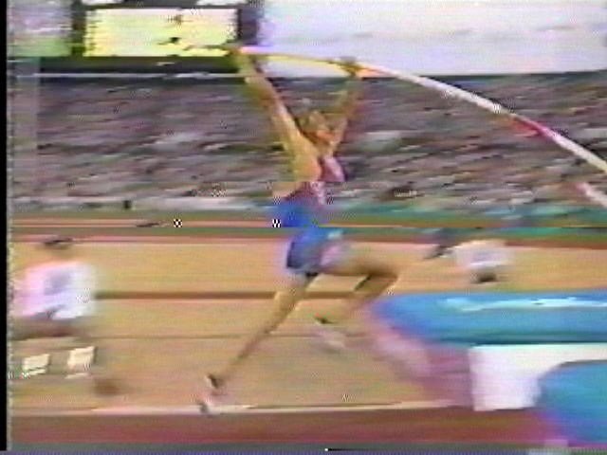

Slide 28
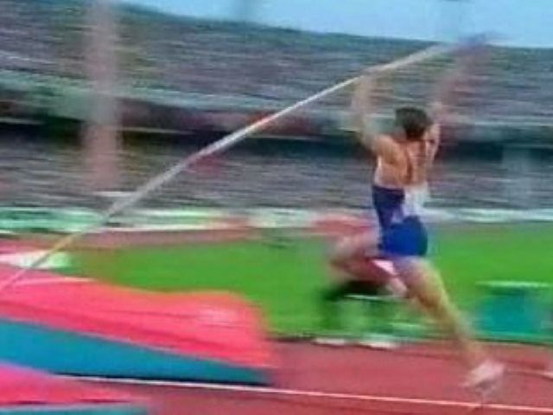

Slide 29
Short Pole Exception
That’s how the “big” vaulters do it
But when your “little” vaulters are learning on a shorter pole – they cannot push their lower arm straight without shoving the pole forward into the box.
Therefore – a bent lower arm is needed until the vaulter is on a longer pole!!!!

Slide 30
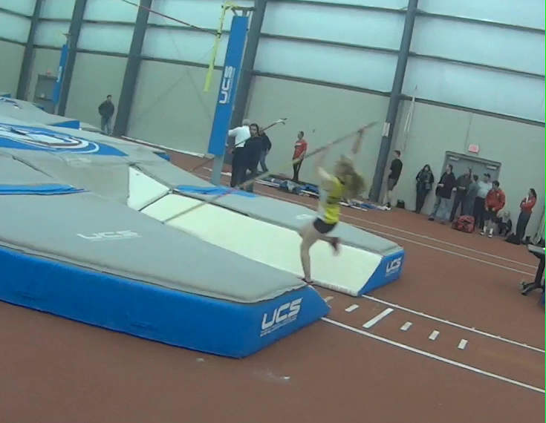

Slide 31
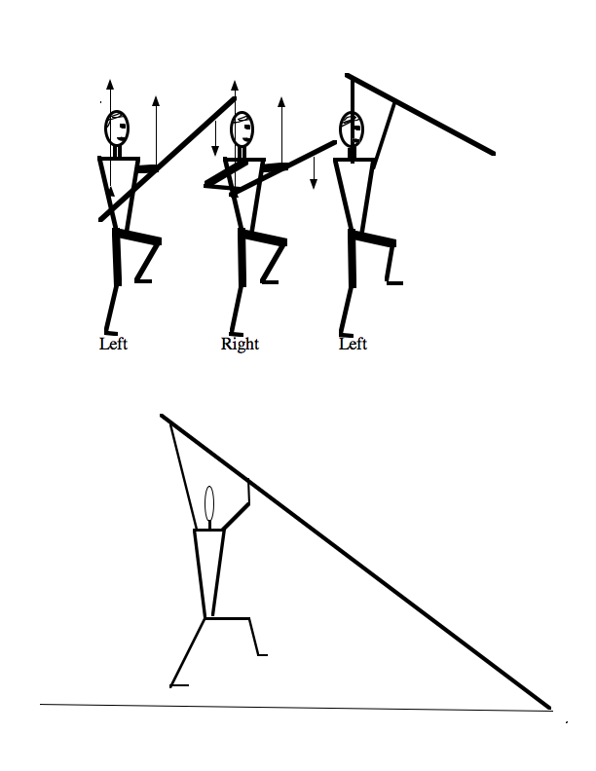
Plant Mechanics

Slide 32
How to Plant the Pole
The plant begins with the gradual dropping of the pole through the run dropping the pole allows it to “free fall” and therefore not have
weight that needs to be carried - pole does not need to be
“directed” or “steered”- falls in straight line to box
The planting action is initiated on the next to last left (the last “1” of 3-2-1’s)
- Initiate the action by raising the right hand into the ribs (from the hip)
Then shoot the right hand directly from the ribs to fully extended overhead position (quickly shrugging the shoulder to allow the hand to pass)

Slide 33
How to Plant the Pole (2)
DO NOT - Push the pole forward or pull it back - raise it directly to vertical
Press the left arm vertically up to the pole (not pushing out into the pole or pulling the pole down to the box - let it fall)
Raise the hips, chest, shoulders, head as vertically as possible
Drive up off of the left foot - drive the right knee up to a 90º angle
- right foot out - toe up
Left toe should be directly under the right hand at takeoff

Slide 34
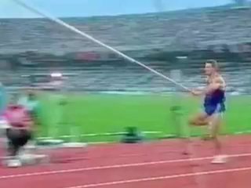

Slide 35
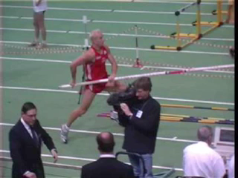

Slide 36
Drills for Plant
- Plant Drills
  - walking stubby left/right/lefts - standing stubby plants - jogging LRL’s - pole walking LRL, pole running LRL, LRL into wall (or box),
  Wall Drill with Lift(hip drill), Sliding Box Drills (all of the above), one arm plant drills
  Pole Run “Free Drops” vaulter runs on track with pole allowing pole to “free drop” from full carry position to ground in order to gauge timing for initiating pole drop
  answers the question - when do I drop the pole

Slide 37
Drive/Swing Phase
Drive - the phase of the vault when the vaulter maintains the plant position as they jump up into the pole.
Swing - the phase of the vault when the vaulter swings from the drive position to the inverted position

Slide 38
Drive/Swing Phase
- Lead with the chest (not hips) underneath the bend of the pole
- both arms, shoulders, chest, hips all maintain press up
- Left leg stays back - push off of toe as long as possible
- Arms pivot with top arm going back and lower arm moving back to head – create “triangle” the head in middle

Slide 39
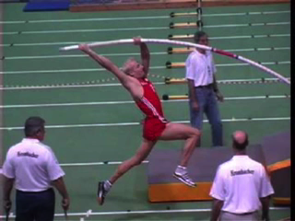

Slide 40
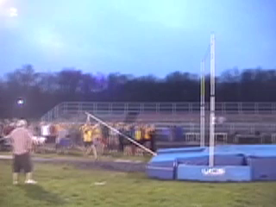

Slide 41
Drive/Swing
The Drive phase ends when the pole stops bending towards the pit, and starts swinging to the side
For novice vaulters who won’t bend the pole, the drive phase won’t happen. They will swing immediately. As they improve their plant - they will increase the drive phase.

Slide 42
Bending the Pole
Many coaches want to “teach” the vaulter how to “bend a pole” by using poles rated below the vaulter’s weight. Vaulters WILL BEND POLES as a RESULT of using the CORRECT technique, and they will do it safely!!
Using underweight poles to “get bend” is a dangerous practice.

Slide 43
Drive/Swing
More advanced vaulters will increase their drive phase by pressing back with their jump leg and allowing their arms to “drag” back. This will also set up the swing phase.
Drive Swing Drills
- Grass Drills (keep left leg down and back), Sand Drills, Pit Drills
- Rope Drill with collapsed left arm (hold drive position)
- short pole stall through, one arm Drills into the pit

Slide 44
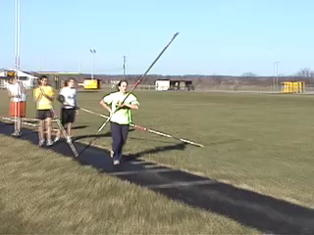
Sand Drills - on the only warm day in January - work on swinging up (don’t worry about a box - plant in the sand!!!)

Slide 45
Swing Up
Close off, Flex-in
Goal: To swing inverted and past the pole before it unbends - allowing the stored energy to go back into the vaulter vertically instead of horizontally
swing left leg (maintain length) past top of pole
drive both arms through to below knees closing off
angle from hands to legs
  then the left arm flexes at elbow – flex in to chest
keep right knee bent through invert - knee “driving”
as inverting - bring pole in-line - and as close to body as
possible

Slide 46
Close Off/Flex In
Take-off leg stays long to top of pole
Hands drives through below knees (closing off gap between legs and pole)
Top arm stays long through to below knee
Bottom arm flexes in, bending at elbow and bringing back of wrist to chest

Slide 47
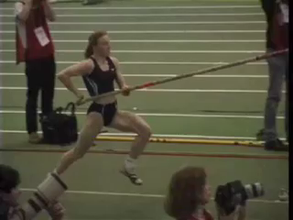

Slide 48
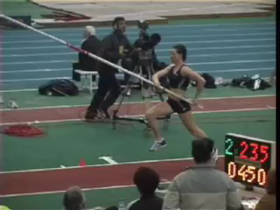

Slide 49
Pull/push turn - fly away - bar clearance
Goal: to maximize bar clearance height
get shot vertically from the top of the pole
release left hand first then right (finishes turning action)
at peak height - pike at hips
“cup out” over bar - do not throw chest into bar - wait for clearance then “snake”
As pole unbends - allow body to shoot straight up the pole
Begin turning hips to the bar - cross right foot over left
Release left hand first - then right (release pole back - do not
“throw”)
Pike as hips peak over bar
cup chest - do not “throw back” head (as chest is thrown out)
wait to “snake” bar - don’t lift head or arms

Slide 50
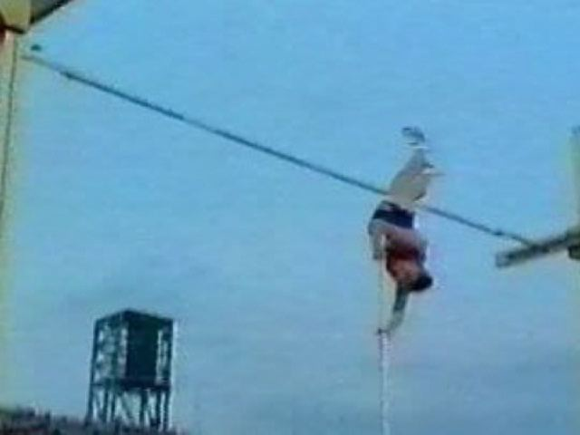

Slide 51
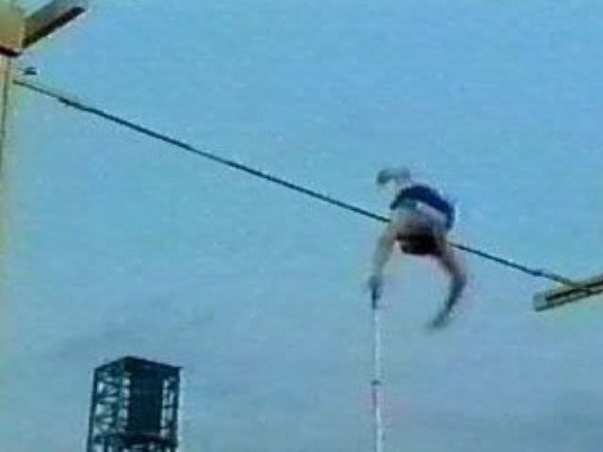

Slide 52
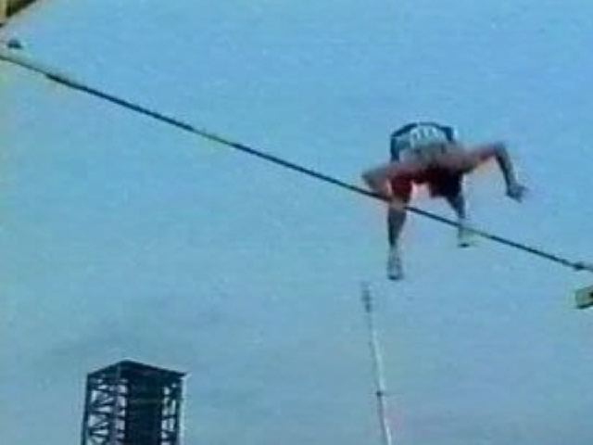

Slide 53
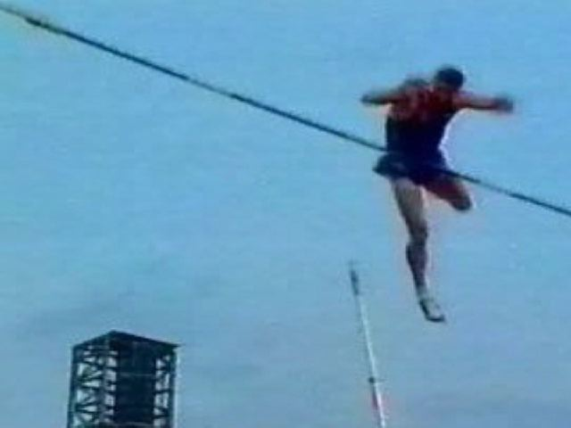

Slide 54
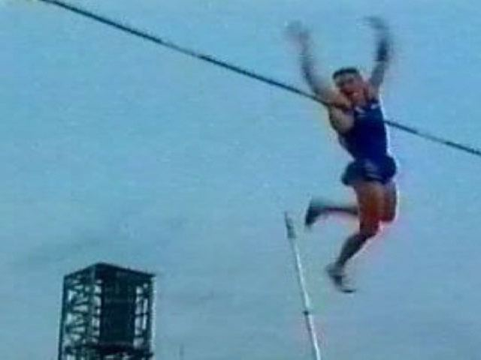

Slide 55
Drills for Bar Clearance
“flex and slide” floor drill,
underwater vaulting,
gymnastic back roll to handstand,
stubby bar clearance drill,
straight pole bar clearance,
trampoline and rope drill to clearance

Slide 56
Pole Vault
Grip Height and
Pole
Selection

Slide 57
Plant Angle
The more acute the angle is from the pole to the pit - the easier it is to get in the pit (pole rotation)
Therefore - gripping down on the pole gets you in the pit - gripping up makes it harder to get in (and land safely)

Slide 58
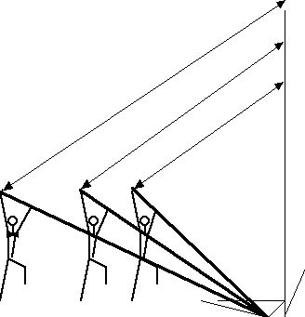
more energy needed
Less energy needed

Slide 59
Grip Height
(where you hold the pole)
- the higher the plant angle - the easier to get enough pole rotation to get into the pit
- the lower the plant angle - the more energy required to rotate the pole into the pit
- grip height is a function of energy - not of height or desire for height

Slide 60
Grip Height
This is a MAJOR SAFETY ISSUE:
IF A VAULTER IS NOT LANDING DEEP ENOUGH IN THE PIT
DROP THEIR GRIP AND THEREFORE
REDUCE THE ENERGY NEEDED TO GET IN!!!!!!

