Slide 1
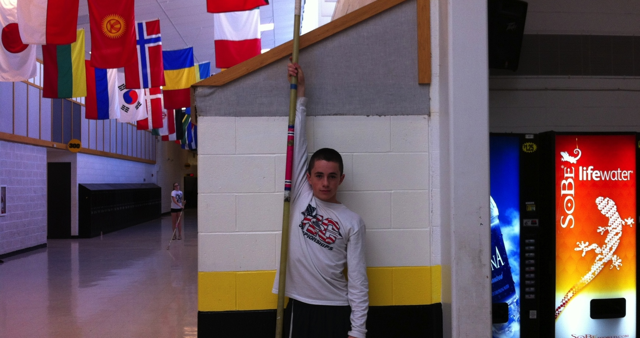
Where New Vaulters Start
The “reach-grip”

Slide 2
Pole Selection
- poles are designed to be vaulted by a vaulter of a given maximum weight
- with average speed, plant ability and height
- poles are designed to be gripped (top hand) between 6” and 18”
- top of the grip range of one pole is the bottom of the grip range of the next
- type of pole used by a vaulter is determined by:
- body weight
- pit penetration (pole rotation v pole bend)
- top hand grip location
- differences in the “brand” of pole used
- difference in barrel size (difference in how fiberglass is wrapped)
- difference in location of sail piece
- not a difference in “test weight” but in response
- a safer way to increase pit penetration - lower grip height!!!!!!!!!!!!!!

Slide 3
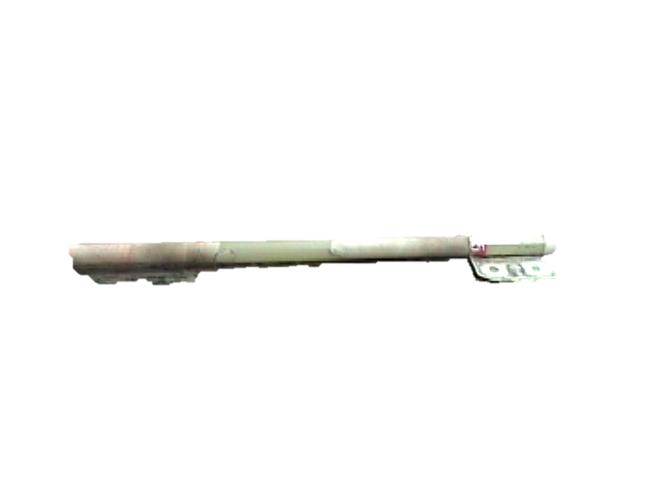
Grip Range – UCS Poles
6” from top
Top hand from 6” to 18”
Note: a $$ bill is 6”

Slide 4
Pole Selection
At the top of the grip ranch (6” down) of a 140 pound pole - the pole will work as a 140 pound pole
For each inch below the top grip, add approx. 1 1/2 pounds
At the bottom of the grip range (18” down) the pole will act like a 158 pound pole
Keep in mind - even though the pole is stiffer, holding down will make the plant angle higher and therefore make it easier to get in the pit!!!

Slide 5
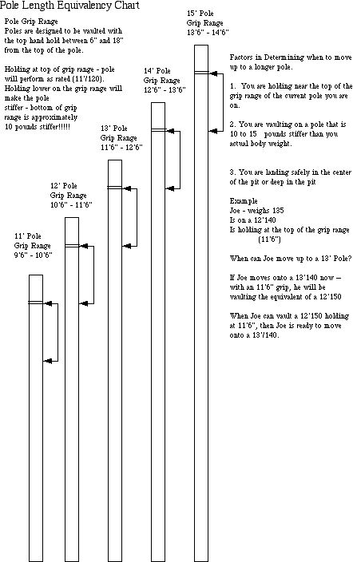

Slide 6
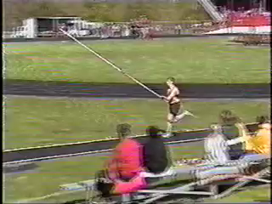
Here’s what happens when the pole gets longer (8” or so because the vaulter missed the box

Slide 7
Effective
Teaching
Methods

Slide 8
Effective Teaching Methods
one arm vaults
- push pole on runway - plant overhead (just top hand)
- swing up on correct side of pole - land on feet in pit
- raise grip height according to penetration
- teaches tall plant, planting with step on, staying long
under pole
- swing long left leg
  More advanced – swing long left leg and body up into pit
  More-More advanced – one armed swing up over bungee
  with pull and turn!!!!-

Slide 9
Effective Teaching Methods
push vaulting
- push pole on runway - holding with both hands but resting top hand
on shoulder
- plant consists of pushing both hands up into air
- execute full vault from plant
- teaches plant/vault mechanics without dealing with run issues
- teaches correct vaulting technique - and safe vaulting
- cannot have a “bad” runway - or a “lip” on the box!!!!!!!!
  rule - boxes with “lips” are illegal
- with both one arms and push/vaults - start at lower hand grip and
  Raise grip (one grip at a time) until vaulter starts to land in the middle of
the pit (instead of over penetrating) if the vaulter comes up
short - lower grip again to improve mechanics

Slide 10
Teaching Progression
Every year in March - we have the “Middle School” Pole Vault night at Watkins. We get 25 to 35 kids - and we teach them pole vaulting in about 2 hours. At the end of the night - they are jumping and excited about pole vault
(and have downed 10 pizzas)
Here’s how we do it. . .

Slide 11
Teaching Progression
1. Pole Orientation (using stubbies) - pole grip, pole carry
2. Pole Run (start with walking, then jogging, then running with stubby)
3. Repeat steps one and two with a suitable pole until athlete can consistently accomplish
4. Plant - standing plant action with stubby
5. Walking plant action with stubby emphasizing correct action to correct foot
6. Running Plant - increasing from jog to running plant action with stubby
7. Repeat steps four, five and six with suitable pole until athlete can consistently accomplish

Slide 12
Teaching Progression (2)
8. Sand Vault (using long jump pit) (note - make sure there are no obstructions to pushing the pole down the runway)
- place a pit section in the long jump pit
- using a three to five left approach, athletes should push the pole
down the runway, “plant” the pole vertically overhead, into the sand in
front of the pit section and jump into the pit on the correct side of the
pole (athlete should work for distance - not height) and land on their
back on the pit
- as the athlete improves technique, athlete can increase swing-up,
and can add pull and turn to land on stomach in the pit

Slide 13
Teaching Progression (3)
9. Push Vault - using the same technique as the Sand Vault into the box and the pole vault pit - some goals apply
10. Vertical Takeoff - using a pole carry and a three to five left approach, athlete should vault into the side of the pole vault pit, planting the pole up against the bottom of the pit. This teaches athletes to use a pole carry, a vertical takeoff, and can be used to achieve the same goals as the sand vault.
11. One Arm Vault - athlete ‘push” vaults using only the top (right) arm - teaches a high plant angle, vertical takeoff, correct pole placement in box and can continue to be used for drive-swing and swing up drills
12. Full Vault - athlete moves to a five to seven left approach. As the athlete achieves greater depth into the pit, coach can move athlete up the pole one hand grip at a time. If run/plant is a serious problem, athlete can “push” vault, but should eventually working on run/plant timing

Slide 14
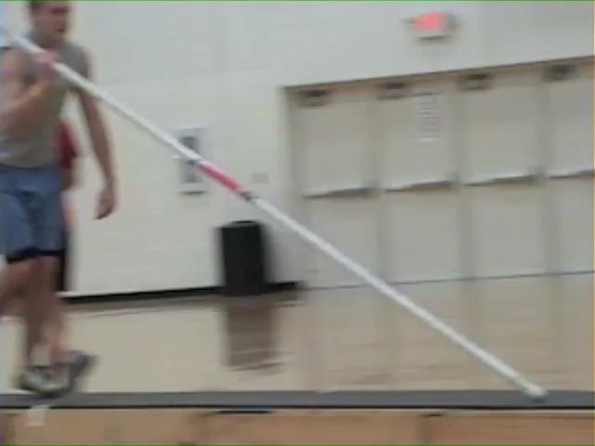
Drills on the Pit Indoors

Slide 15
Equipment
And
Safety

Slide 16
Pole Vault - Equipment Safety
Goal - To vault in a safe environment
Pit Location
- is it in a “high traffic” area - where accidents, equipment, and people are likely to interfere
- is it in a easily supervised area - where a coach with multiple responsibilities can observe practice
-is it in an appropriate place for prevailing winds

Slide 17
Equipment Safety
Box Condition
- is the box legal (105º) or 90º - and has it been set
  properly (leveled)
- is the box anchored and is it intact - and is there a lip on
the box
- is the box padded with an ASTM approved box collar

Slide 18
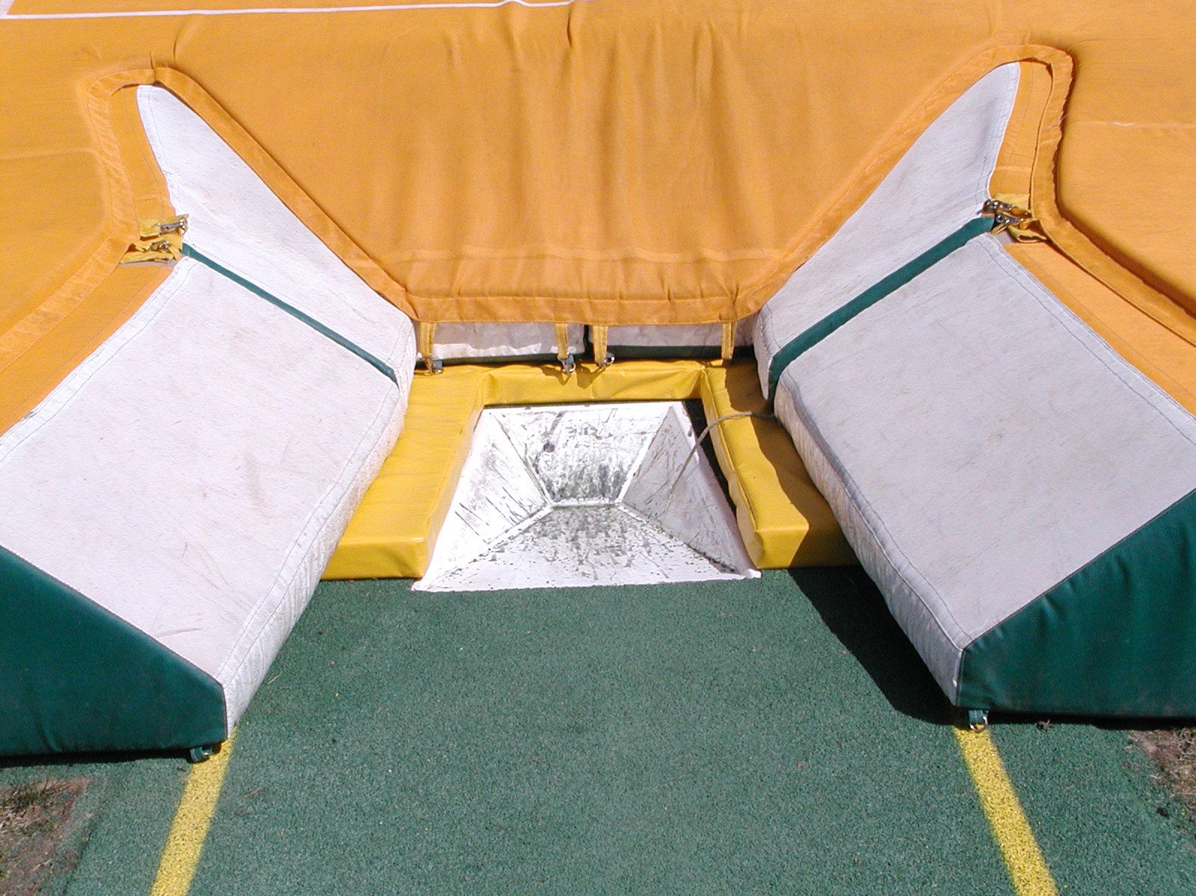
Note: this is an older slide – and therefore NOT an ASTM approved box collar

Slide 19
Equipment Safety
Size of Pit
- rules - 20’2” length - 19’8” width.
16’6 wide in front of the standards
16’5” depth behind the box
- is the pit covered with a common cover
- are there insets for the standards (if not it cannot be legal)

Slide 20
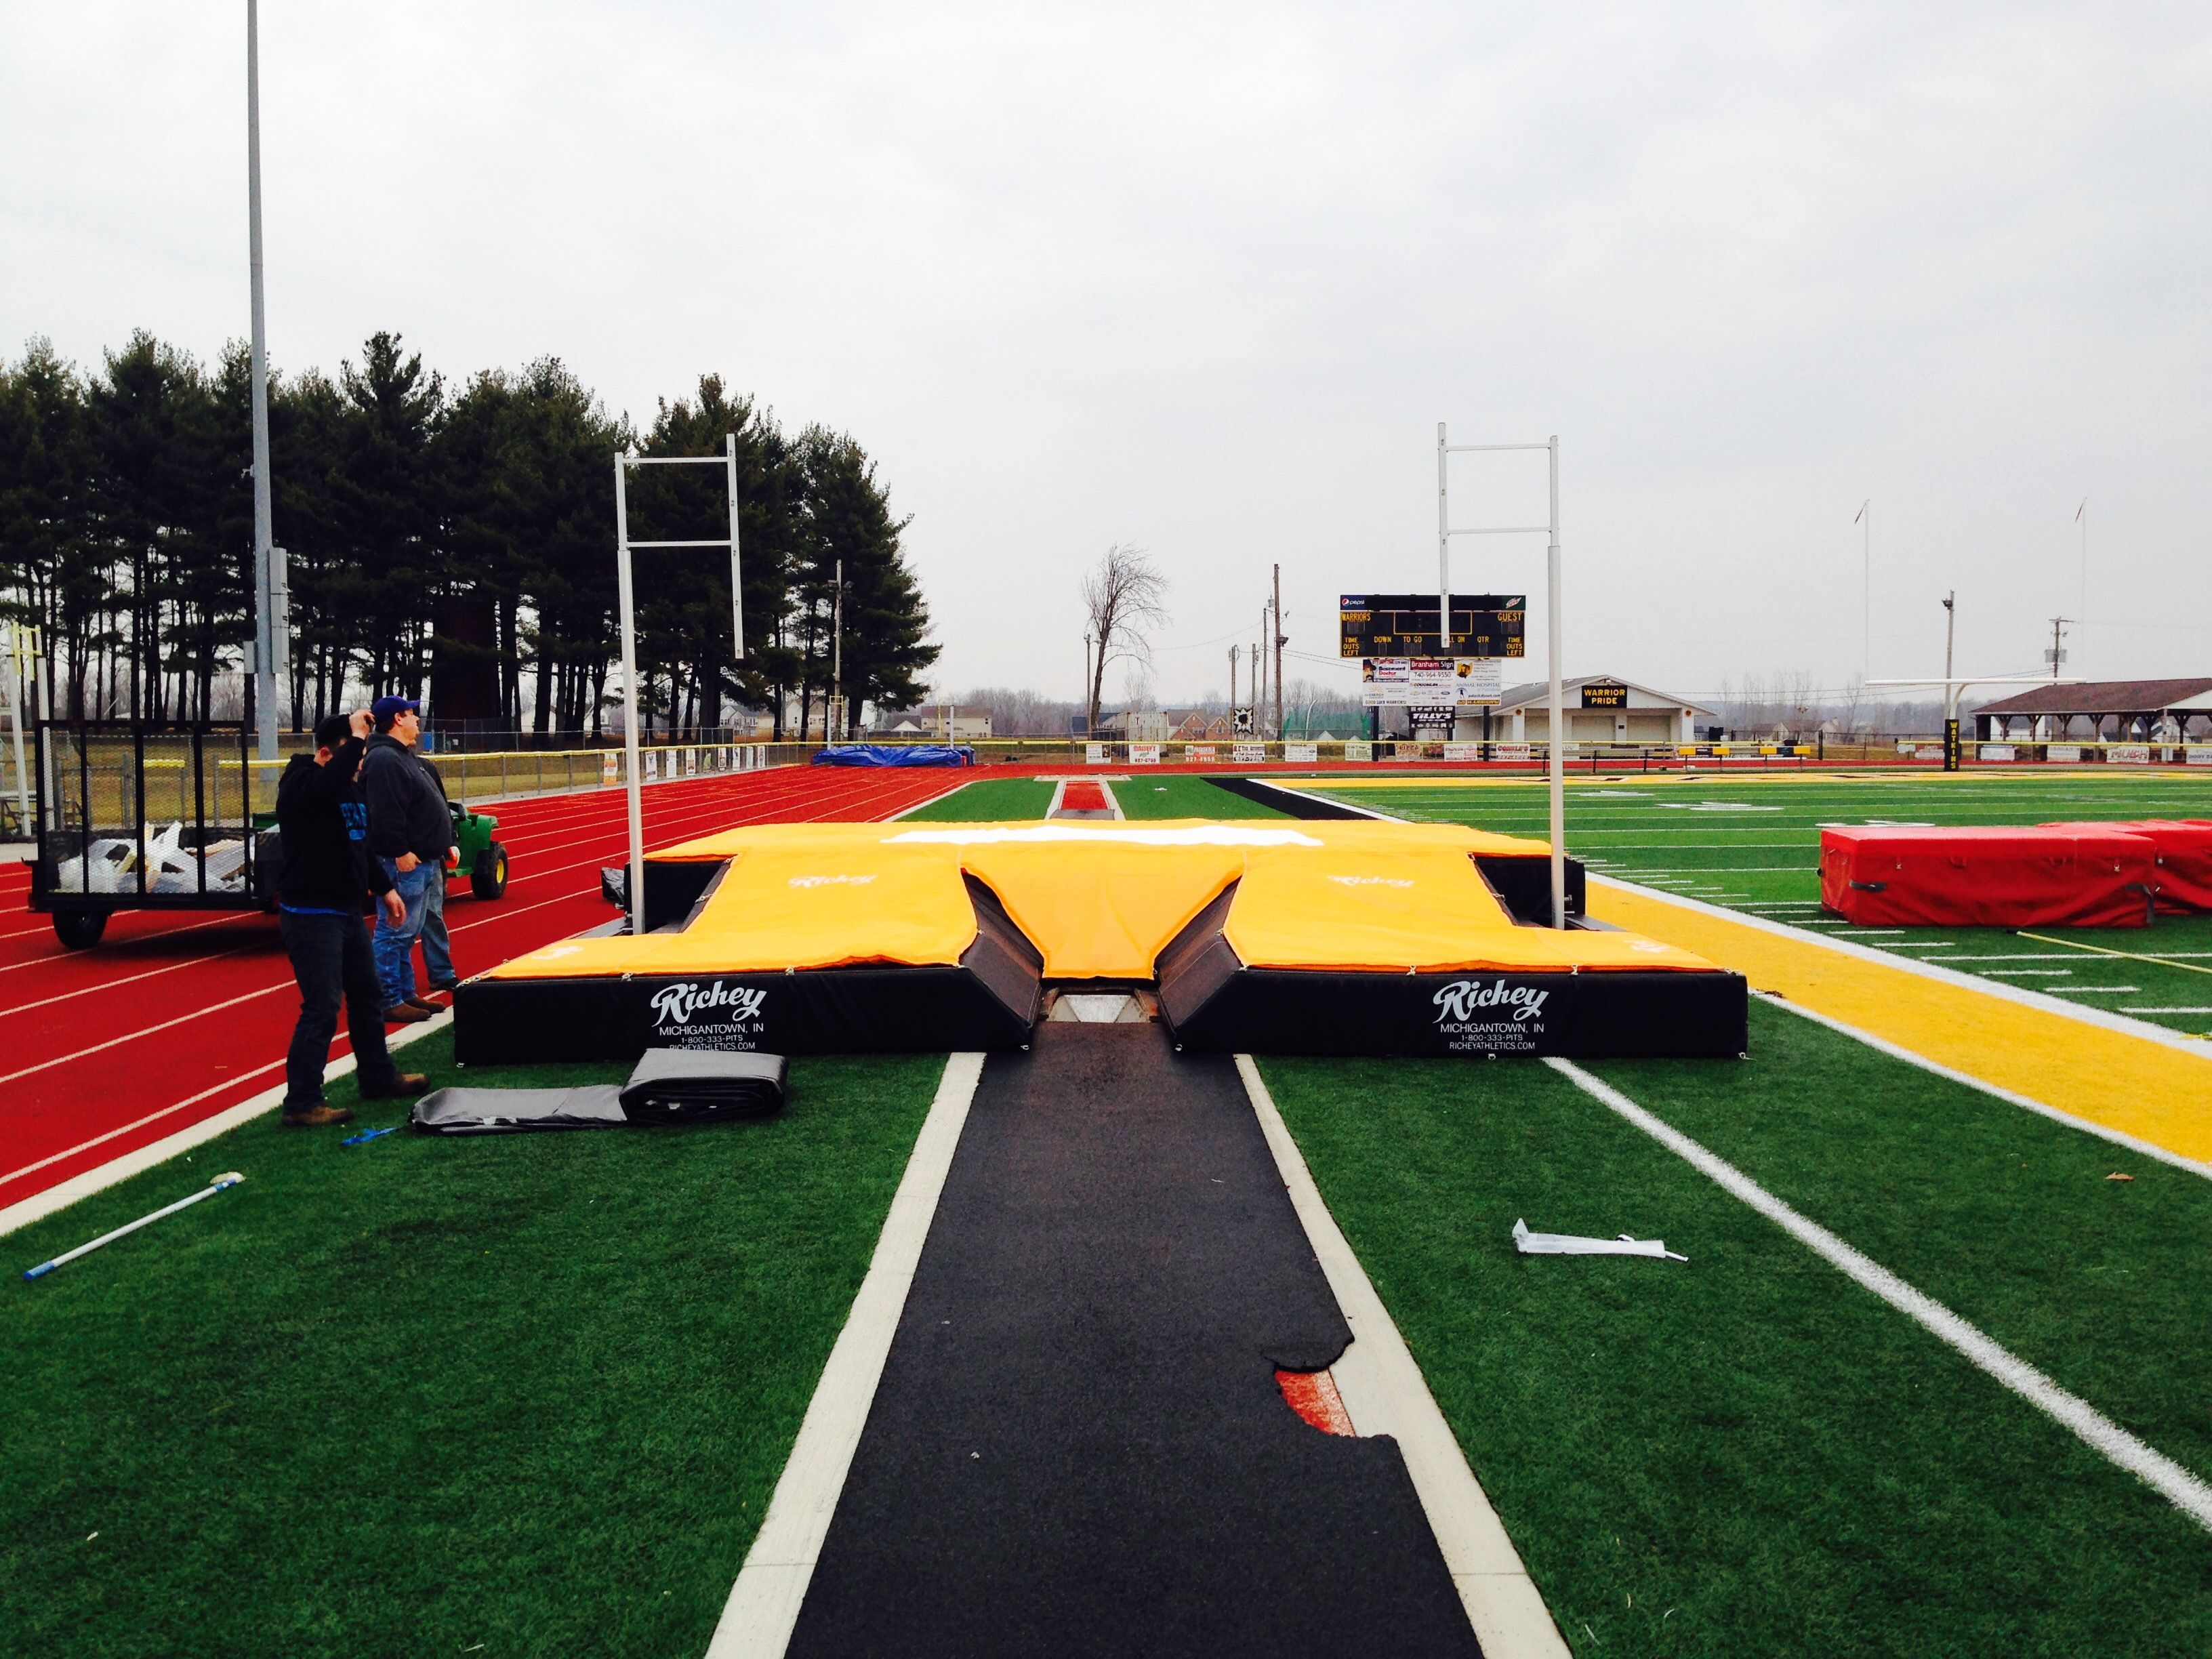

Slide 21
The New Box Collar Rule (2015)
The National High School Federation 2015 rule
the “box collar” must meet ASTM standards
The question is – what are ASTM standards
The standards are set to equal these box collars:

Slide 22
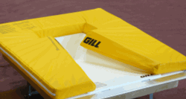
The Gill Safety-Max Collar

Slide 23
UCS Box Collar

Slide 24
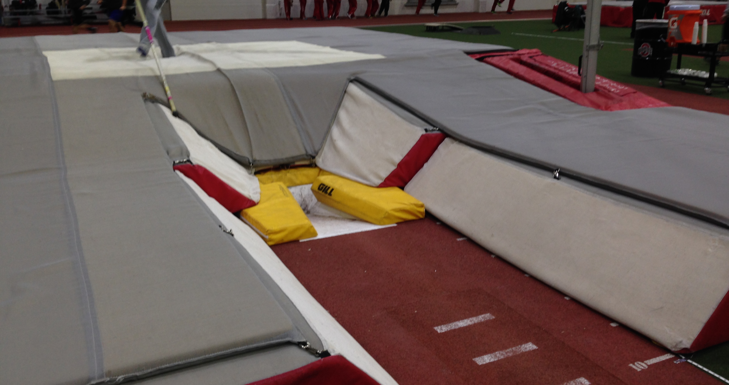
Gill Box Collar Installed

Slide 25
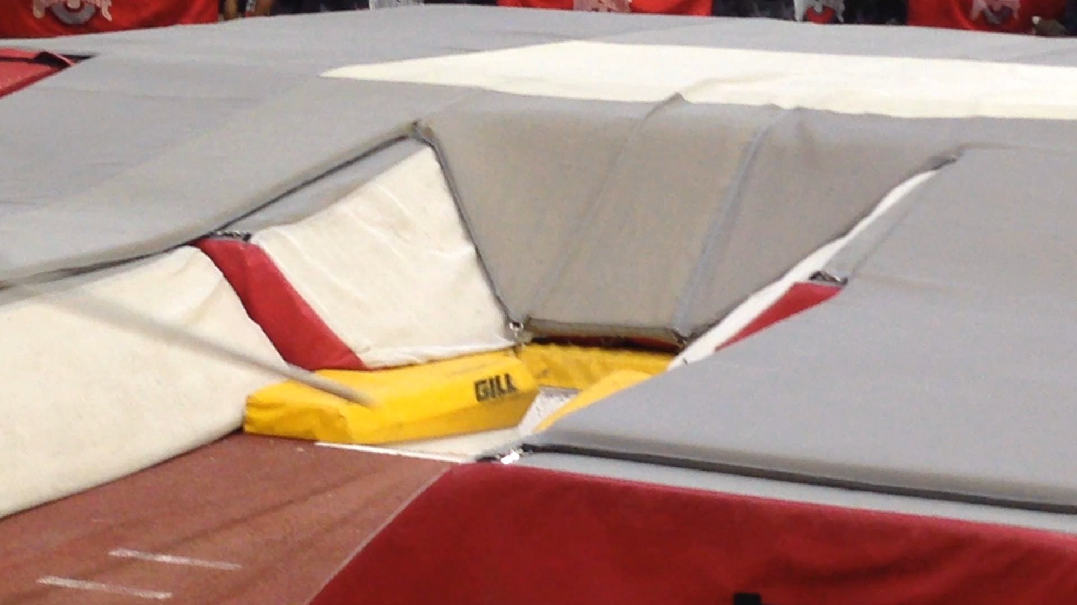
Coaching Concern:
Make sure the box collar is properly installed and has not moved a moved box collar could interfere with the proper bending and unbending of the pole

Slide 26
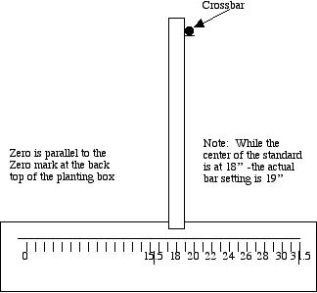
Equipment Safety
Standard Settings
- by rule- standards
are now from
18” to 31.5”
(45 to 80 cm)
(new since 2013)

Slide 27
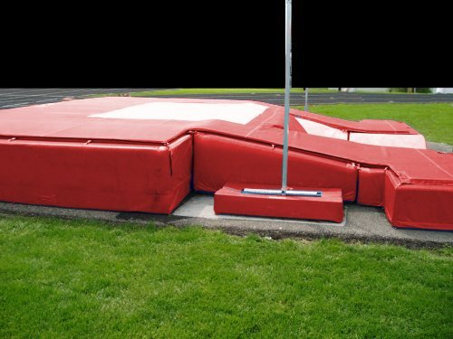
Equipment Safety
Standards
must be
anchored and
padded (no
Exposed hard
Surfaces)

Slide 28
Equipment Safety
Pit Inspection
- are their holes in the pit - areas where vaulters will “go through”
- is the foam intact and will the cover allow for a vaulter to walk/run on it
- are all hardened areas around the pit covered
- are all dangers removed from the pit (pallets, cinder blocks, hurdles)

Slide 29
WARNING!!!
MOST RECENT FATAL INJURIES HAVE OCCURRED FROM VAULTERS EITHER MISSING THE PIT AND HITTING HARD SURFACES - OR ROLLING OFF OF THE PIT ONTO HARD SURFACES -- YOU CAN PREVENT THIS FROM HAPPENING

Slide 30
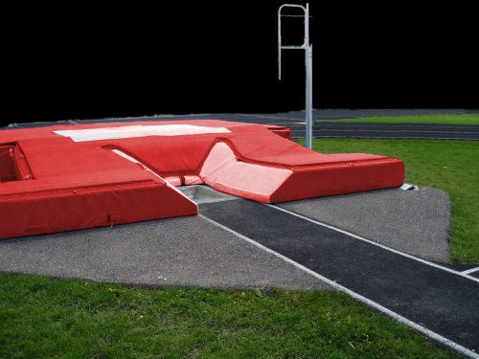
Equipment Safety
It’s a nice pit - but
There’s asphalt all
Around where the
Vaulter might “abort”
And land. That needs
To be padded

Slide 31
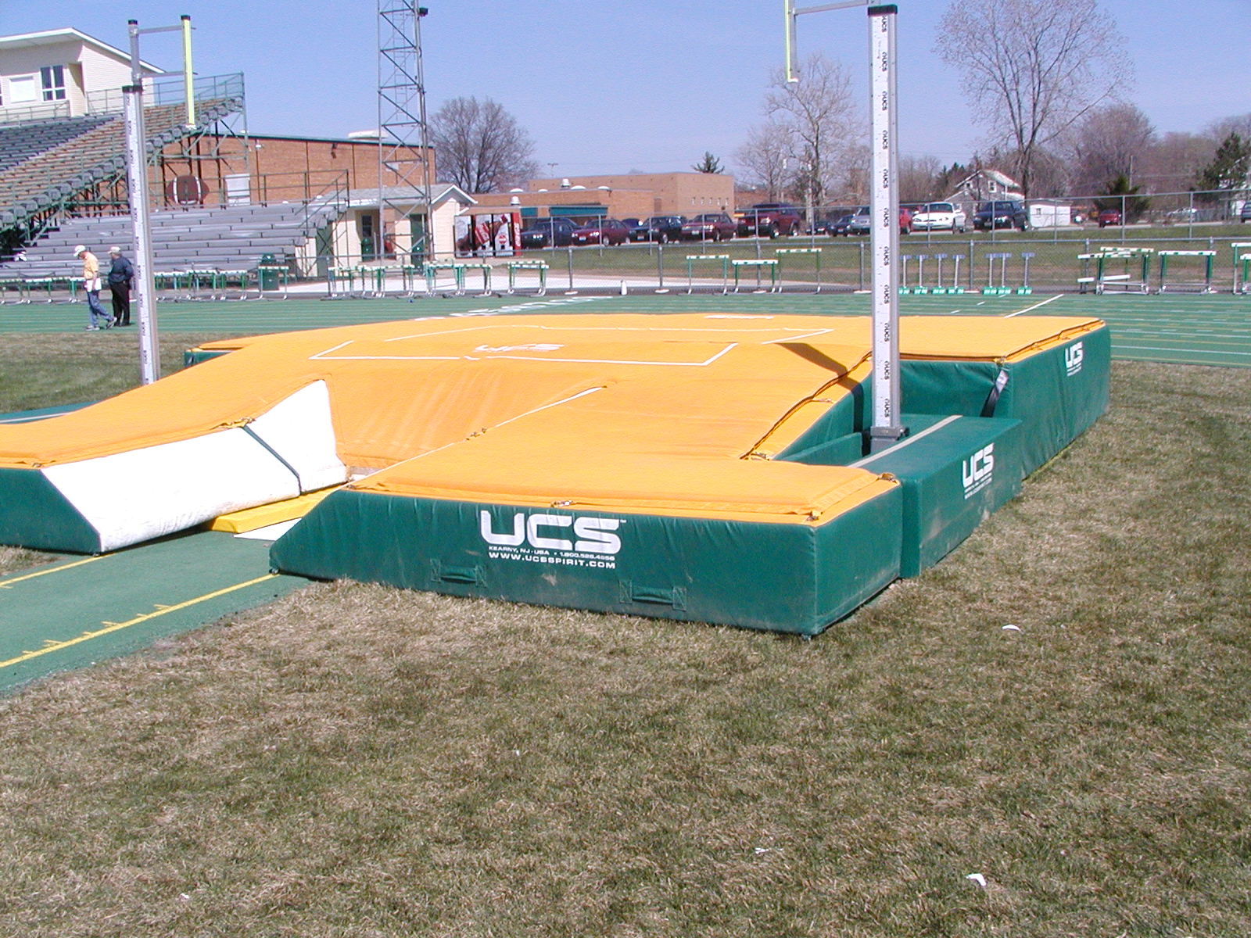

Slide 32
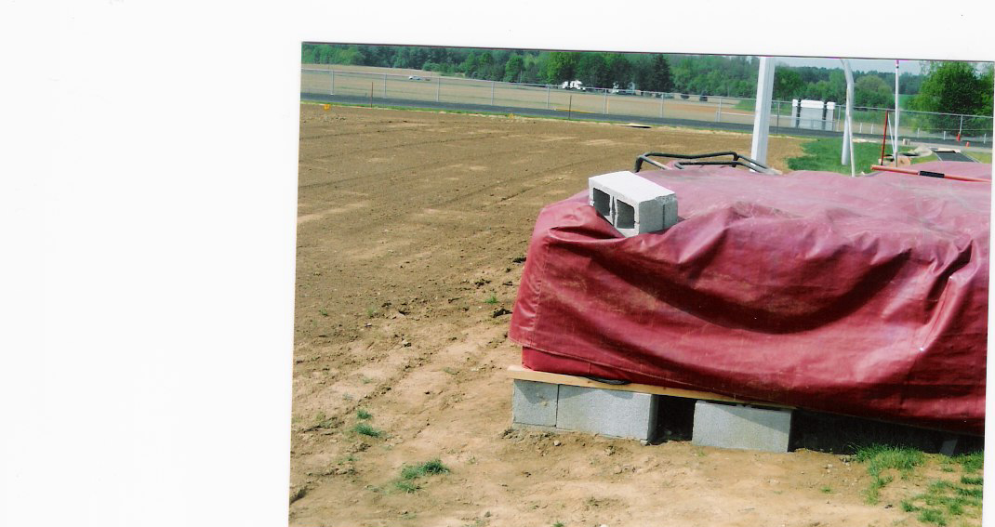
Bad Pit – Vaulted at Districts!!

Slide 33
Equipment Safety
Runway Environment
- is the runway intact (no holes) and appropriately marked
- are marks placed on the runway safe from being
moved/removed
- are there likely to be people walking/running across the
runway
- is the runway secured in such a way as to make it safe

Slide 34
Equipment Safety
Vaulter attitude
- are vaulters prepared to make safe vaults through:
- appropriate training
- attitude toward consistency and safety
- no kamikaze vaulters
- are vaulters willing to accept coaching and make appropriate
changes during competition
- are vaulters using appropriate and legal poles

Slide 35
Equipment Safety
pole conditions
- have poles been inspected for legality and safety
- are pole clearly marked to avoid confusion
- have poles been checked for cracks and bruises
- are butt plugs in acceptable condition
- are poles stored in such a way as to avoid scratches and
crushes
- are poles kept dry and secure at meet
- are vaulters gripping poles in a safe manner

Slide 36
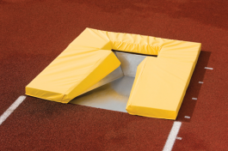
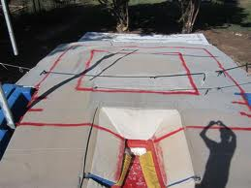

Equipment Safety
Helmets????? New Box Collars???
Soft Boxes??? Landing Zone Rules??

Slide 37
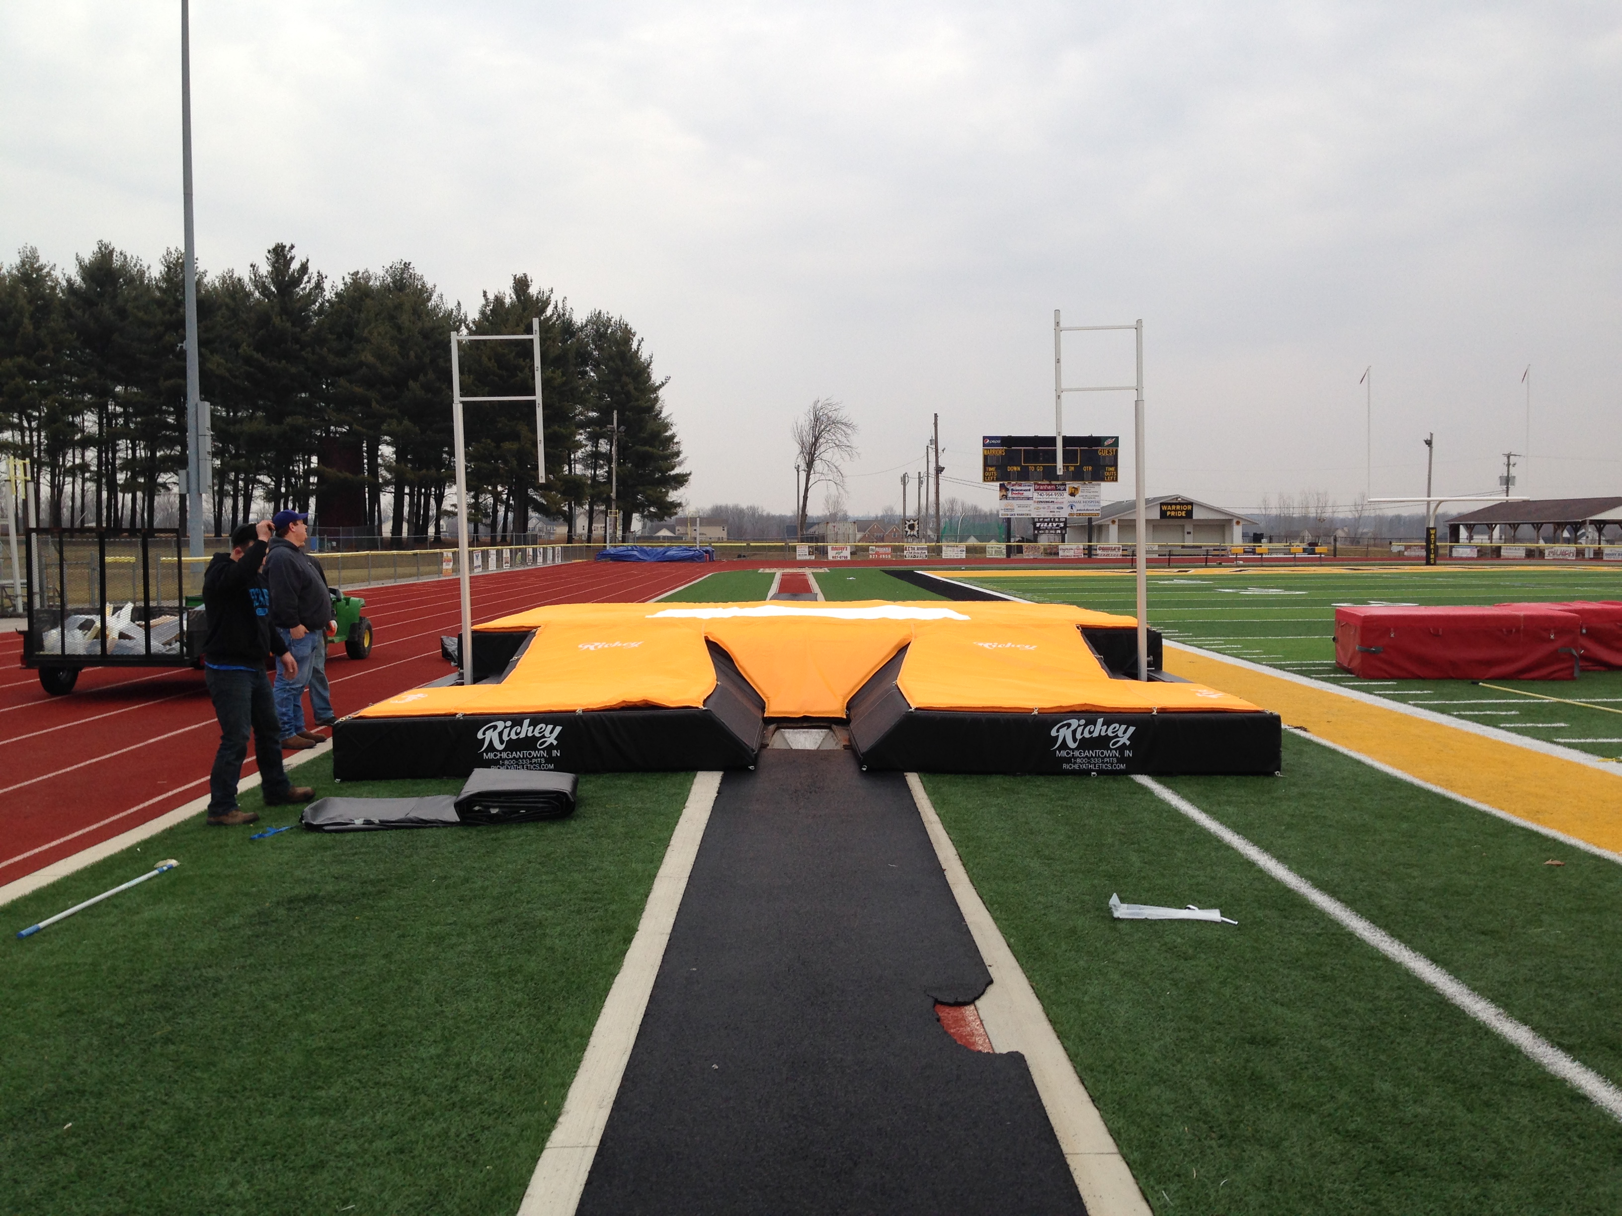
Equipment Safety
Lots of ways to try to get kids to “land in the big black and gold thing”
(the first rule of “Watkins Pole Vaulters”)
Problem – will the added expense cause
Schools to simply stop vaulting?
In the end the biggest safety factor is:

Slide 38
            YOU
            THE
            COACH

Slide 39
YOU THE COACH
- the attitude you set for your athletes
- your willingness to commit to safety
- your supervision of your kids
- your knowledge of safe vault coaching
- your enthusiasm for
        DOING IT RIGHT!!!!

Slide 40
Rules
And
Problem Solving

Slide 41
Rules
VI. Pole Vault Competition Rules
Note - this is not intended as a “complete” Pole Vault rule discussion. For further rule clarification and detail, please go to www.watkinstrack.org and view the Pole Vault Officiating Presentation.
A. The Pole
must be rated at a weight greater than the vaulter
must be legally marked
may have taped handholds – but must be smooth with no ridges
handholds may NOT cover the “top grip” label
B. The Standards
may be set between 18” inches behind the “zero” mark
(back/top of the box) to 31 1/2” inches behind the “zero” mark
(NEW RULE 2013 FOR HIGH SCHOOL)

Slide 42
Rules
C. The Vaulter
Must be “legally” attired
Must initiate (start running down the runway) within 1:00 (new in 2014) of being called
May not regrip the top hand upwards after leaving the ground (but can move it down or move the lower hand up - but the lower hand may not go above the upper hand - climbing)
Can abort an approach run and try again (even if both feet leave the ground). under current rules - once the vaulter leaves the ground in an attempt to clear the bar - it IS an attempt
May clear the bar and land in the pit in any manner - as long as they do not touch the bar with their hand(s) in an attempt to steady it
Must attempt to release the pole in a manner to not hit the crossbar. If it DOES knock the crossbar off - it is the officials determination if the pole was properly released.

Slide 43
Problem Solving - Standards
goal: to increase safety by solving problems in vault
standards - vault deep ALL THE TIME
- gets vaulters in the habit of penetrating
- thinking in terms of storing energy - not simply “going up”
- gives room for error in case of poor plant
- use of bungee - gives vaulter a sense of penetration as well as height
- in competition standard settings are still the same 18 -31 1/2 ”
- if a vaulter is practicing at 24” to 30” - then competes at 18”
there is something wrong
- check position of left arm at plant (probably collapsing), or
- look to plant step (probably under), or
- look to chest drive at plant - leading with hips
- check “hip drill” to see what happens

Slide 44
Problem Solving - Pole Run
problems with pole run
- not maintaining speed to plant
- Running Mechanics - Pole Carry Mechanics(is pole behind hip)
- is athlete running with high knees and erect body posture
- is pole approaching in a straight line (not angled to box)
- is all pole motion during run “in line” (not side to side)
- is pole dropping too soon -- too late
- is vaulter slowing down to plant (move back)
- is vaulter counting steps (maintaining consistent run)

Slide 45
Problem Solving - Pole Run(2)
- not getting in position to effectively plant
- inconsistency in plant step (midpoint)
- is vaulter “counting” steps
- is vaulter using and adjusting to a midpoint
- is vaulter changing rhythm in competition
- is vaulter changing pole carry
- is vaulter injured or otherwise impaired (tired)

Slide 46
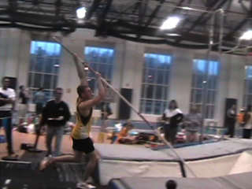

Slide 47
Problem Solving - Plant
inability to vault “straight”
- vaulting straight is a plant action problem - it is not controllable
by attempting to control “where you jump from”
- athletes are off-angle in their plant foot because of the mechanics of their pole carry and planting action
- fix the pole carry and plant to fix the off-angle attack

Slide 48
Problem Solving - Plant (2)
ineffective planting action - erratic forces in plant action
- plant is too early (vaulter loses speed, also forces plant to be
horizontal rather than vertical)
- plant is too late (vaulter slows to put plant up, plant is not complete prior to takeoff, vaulter tries to “muscle” pole, completes press after leaving
ground forcing action down instead of up)
- Plant is “Roundhoused” (vaulter steps to side on jump step)
vaulter jumps from right to left instead of in straight line
Plant is brought down across body instead of in a straight line
- pole carry is not in line with run
- left to right rotation of pole creates a right to left rotation of body -
plant is on the left side of the runway or
vaulter compensates - crosses last step over to right side of
runway

Slide 49
Problem Solving - Plant (3)
pushing instead of pressing
- failure to press - loss of energy
- loss of vertical inches creating more acute angle at plant
- fails to store maximum energy - shoulders and elbows absorb
energy
- pushing - put body “behind” the plant
- will create a lot of bend - but will leave vaulter short at top of
vault
- vaulter looks great through plant - but unable to rotate to vertical
or close off
- tends to block with left arm - body rotates through left hand and
shoulder instead of right hand
- creates horizontal energy - but not vertical energy
- stores energy low in the pole - pole “unbends” early

Slide 50
Problem Solving - Plant (4)
failure to convert horizontal to vertical energy
- check other plant issues first
- check “attack” angle of vaulter (as measured from chest
angle to horizontal)
- check step - if vaulter is “out” it will create a “push plant”
listen to plant - a “pushed” plant sounds like a “stick”
- a pressed plant slides in the box to the back

Slide 51
Pole Selection
grip height determination (assuming on a legal pole)
- grip height is determined by penetration
- if the vaulter is penetrating - grip height can be raised
- raise no more than one grip (hand grip width) at a time
- if the vaulter then over-penetrates (lands too deep)
- go to a stiffer pole (match or lower grip depending on how much
stiffer)
- if the vaulter starts to come up short - lower grip height - check
plant mechanics
- grip (top hand position) between 6” and 18” from top of pole

Slide 52
Coaching Zone
use of “coaching zone” in pit (see diagram)
- Coaching Zone can determine
- depth of plant (energy storage)
- erratic forces in plant (off line plants)
- when to make changes in pole selection
- other problems

Slide 53
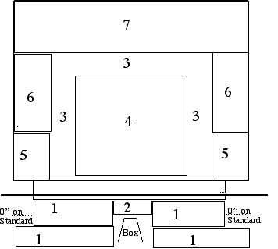

Slide 54
Questions????? www.watkinstrack.org
The author would like to acknowledge the following for the participation (knowing and unknowing) in this presentation:
  Greg Fraunfelter – Past President, OAT-CCC
  The OAT-CCC Executive Committee
  Mark Hannay, Former Chairman, USATF Northeast Pole Vault Development Committee
  Great Videos from http://www.stabhochsprung.com/
  Alan Roark - Coach, Amherst Steele High School for Equipment Pictures
  Rob Wahl – Coach, Altoona Area High School for ideas and rules suggestions!!
  and the following Watkins Memorial High School vaulters (who often only see their mistakes in these presentations!!!!!)
  Kyle Burns - (vaulted at the Ohio State University – now a Chicago Police Officer)
  Austin Jackson – (forner Coach at Athens High School now teaching West Viriginia) Scott Thomas - (now raising and training horses)
  Zach Novotni - (vaulted in college now a nurse)
  Michelle Robbins – (former college vaulter and high school coach, now a nurse)

Slide 55
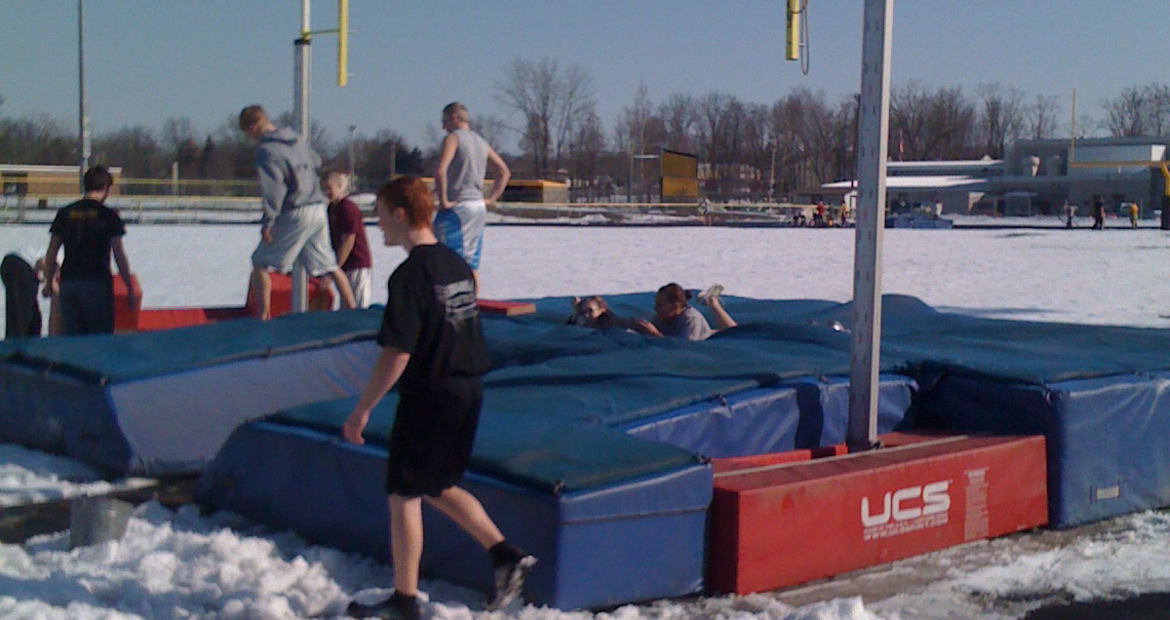
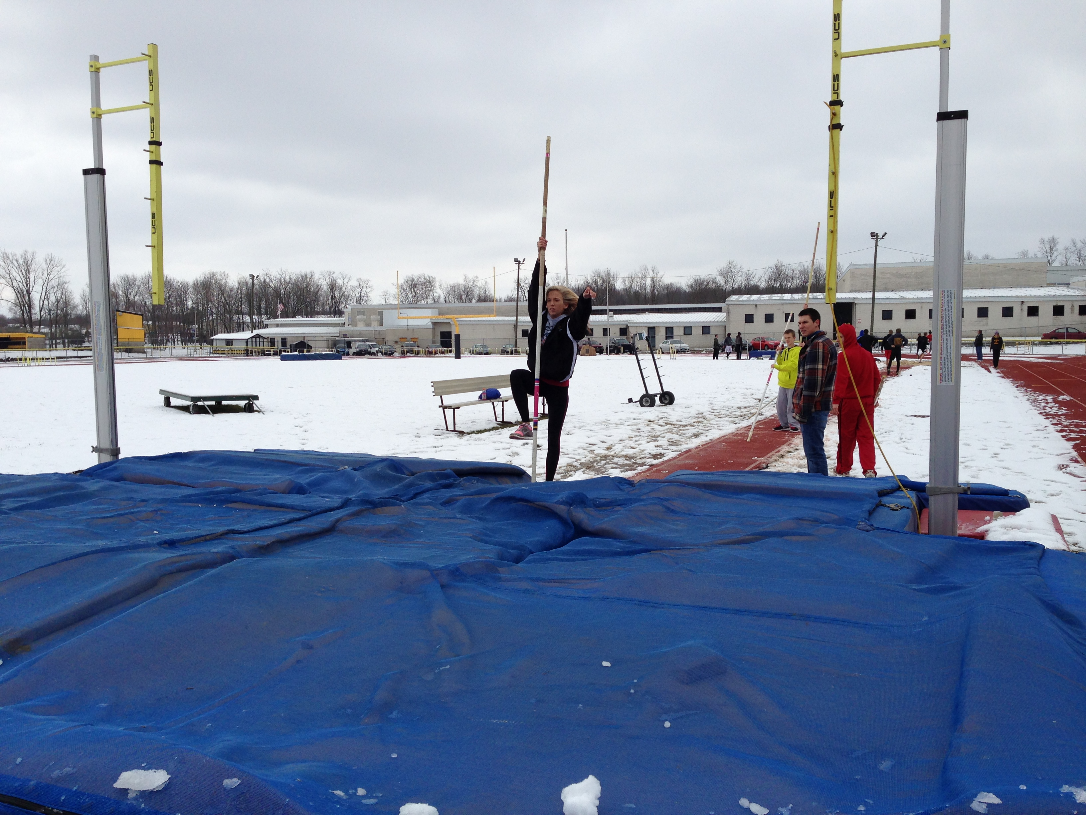
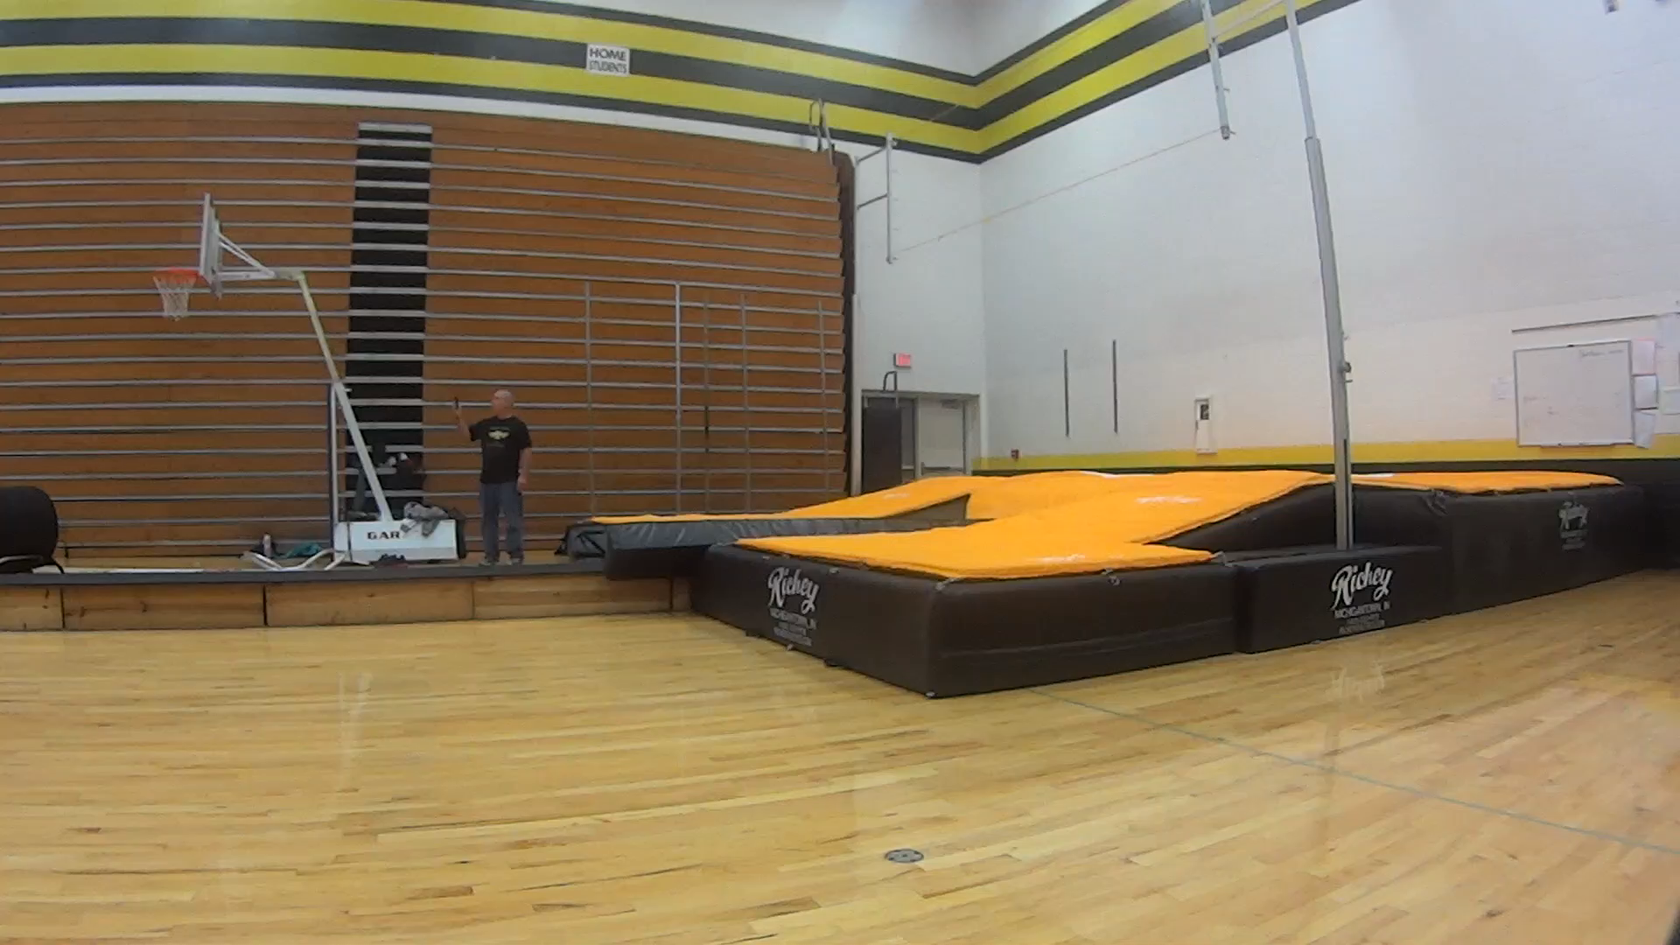
Are you ready to vault?

