Slide 1
Officiating the Pole Vault
By Marty Dahlman
Track Coach, Watkins Memorial High School
Pole Vault Safety, Ohio Track Coaches Association
Pole Vault Sub-Committee Member - ASTM
Certified Track Official - 1978 – 2003
Updated – Winter 2015

Slide 2
Pole Vault Officiating
Goals of Officiating Pole Vault
- Safety of Athletes
- Safety of Officials and Workers
- Fairness to all Athletes
- Efficiency of Event

Slide 3
Pole Vault Officiating
Topics
1. Venue Inspection
2. Pole/Vaulter Inspection
3. Conducting the Event
4. Competition Rules and Practices

Slide 4
Pole Vault Officiating Venue Inspection
The Referee and Head Field Judge are responsible for the inspection of the field event venues.
The pole vault requires the following areas to pass inspection:
- the pole vault pit (mat)
Must be of legal size

Slide 5
7-5-7 Overall Landing System
“The overall size of the pole vault landing pad shall be a minimum of 19 feet, 8 inches (6M) wide by 20 feet, 2 inches deep.
The landing surface measured beyond the back of the standard bases shall be a minimum of 19 feet, 8 inches (6M) wide.
The dimension of the landing surface in the back of the vaulting box to the back of the landing pad shall be 16 feet, 5 inches (5M) deep.
The material of the pad shall be high enough and of a composition that will decelerate the landing.
When the landing pad is made up of two or more sections, the landing surface shall include a common cover pad extending over all sections.

Slide 6
7-5-8 Front Section Buns and Planting Box Cutout
“The front sections of the landing pad, known as front buns, shall be a minimum of 16 feet, 5 inches (5M) wide so as to cover the entire area around the landing box to the inside edge of the standard bases up to the front edge of the plant box.
The maximum cutout for the planting box shall be 36 inches (914 mm) in width, measured across the bottom of the cutout. The edges of the front of the landing pad immediately behind the planting box shall not be placed more than 3 inches (76 mm) from the top of the back of the planting box. The front pad shall be attached to the main landing pad or encased in a common cover.”
Note: In the pole vault, the front cutout tapered away from the planting box allows the pole to bend uninhibited.

Slide 7
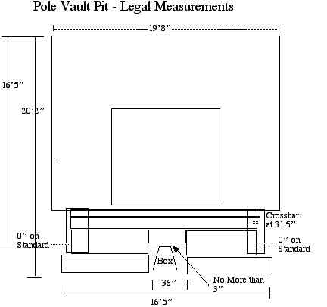
A legal Pit:
19’8” across the back
20’2” total length (front to back)
16’5” from the back of the box (the “0” mark) to the back of the pit
19’8” wide behind the “Standard Cutouts”
No more than 36” opening at the box
No more than 3” from the back of the box to the front edge of the landing pad
Should have a sloped cut out behind the box to allow the pole to bend

Slide 8
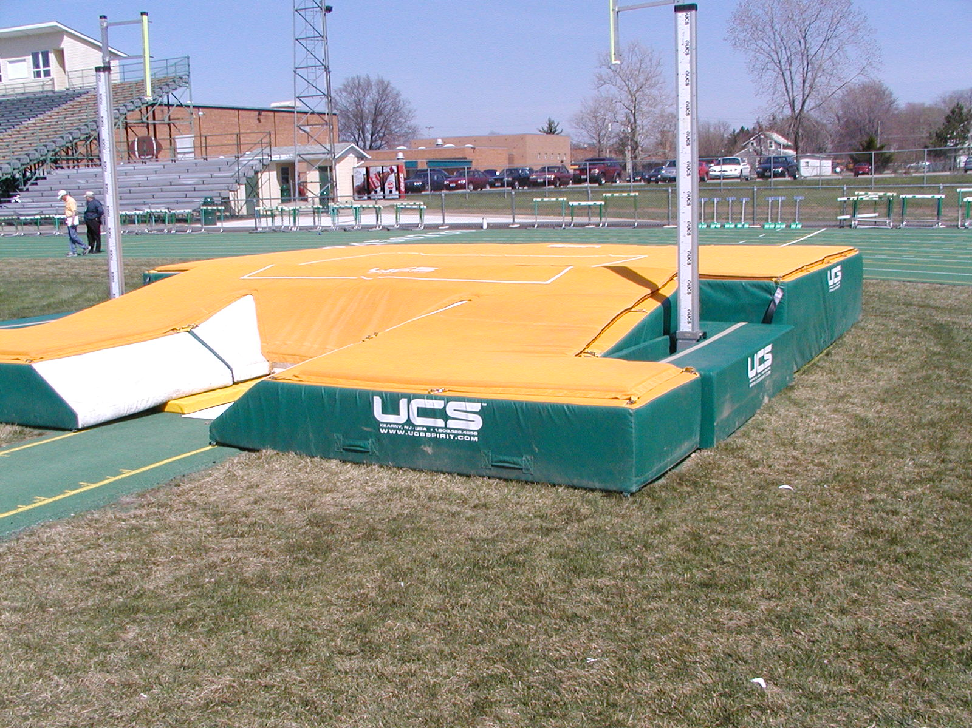

Slide 9
HARD AND UNYIELDING SURFACES Page 57 Rule Book 7-5-11
“Hard or unyielding surfaces, such as but not limited to concrete, metal,
wood, or asphalt around the landing pad, or between the plant box and the landing pad, shall be padded or cushioned with a minimum of 2 inches of dense foam or other suitable material(s).
Note:
It is recommended that any excess material such as asphalt or concrete that extends out from beneath the landing pad be removed.”

Slide 10
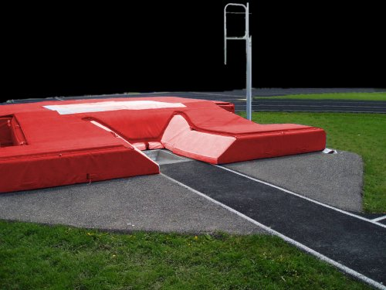
Good Pit - Bad Asphalt Hard surfaces must be padded

Slide 11
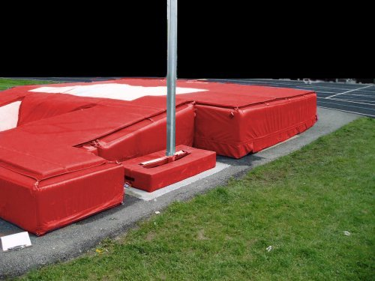
Pit is ILLEGAL
NOW
It Could be legal
WHEN -
Exposed asphalt is padded
Area around standards is padded as well

Slide 12
What’s hard and unyielding???
Asphalt - Track Surface - Posts (fence)
How much should be padded?
At least 3’ beyond the legal pit
What’s Not???
Grass - Pads
If a vaulter misses the pit - what does
He/she land on???????????????????

Slide 13
Both of these pits had OHSAA qualifying competitions conducted on them.
The top pit has exposed asphalt that needed to be covered (and wasn’t).
The lower pit is set up on concrete blocks and boards. The boards stick out from beneath the pits - and an athlete DID hit them and was unable to continue in the event.

Slide 14
Walk Around - Inspection
Walk around the pit and remove:
The cinder blocks, hurdles and other stuff used to hold the cover on
The posts holding flags, streamers, or other crowd control devices too close to the pits
The rake someone dropped off from the long jump
Whatever else that could possibly impale, break, concuss or otherwise hurt an errant vaulter

Slide 15
The Box
The area around the planting box needs to be padded with an “ASTM” certified box padding system (new 2015). As an official, YOU are responsible to make sure that not only is that system there, but also is place correctly (more about this later).
Note: the ASTM (originally the American Society for Testing and Measurement – now ASTM International), establishes standards for all kinds of products, including sporting goods. It is generally a manufacturer based organization, with consumers also represented. Membership is self-selecting and voluntary.

Slide 16
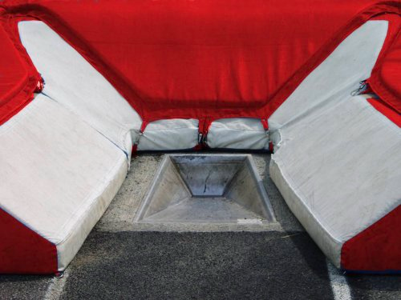
Good Pit
Bad Box Area with exposed concrete. Needs to be an ASTM approved pad on the area

Slide 17
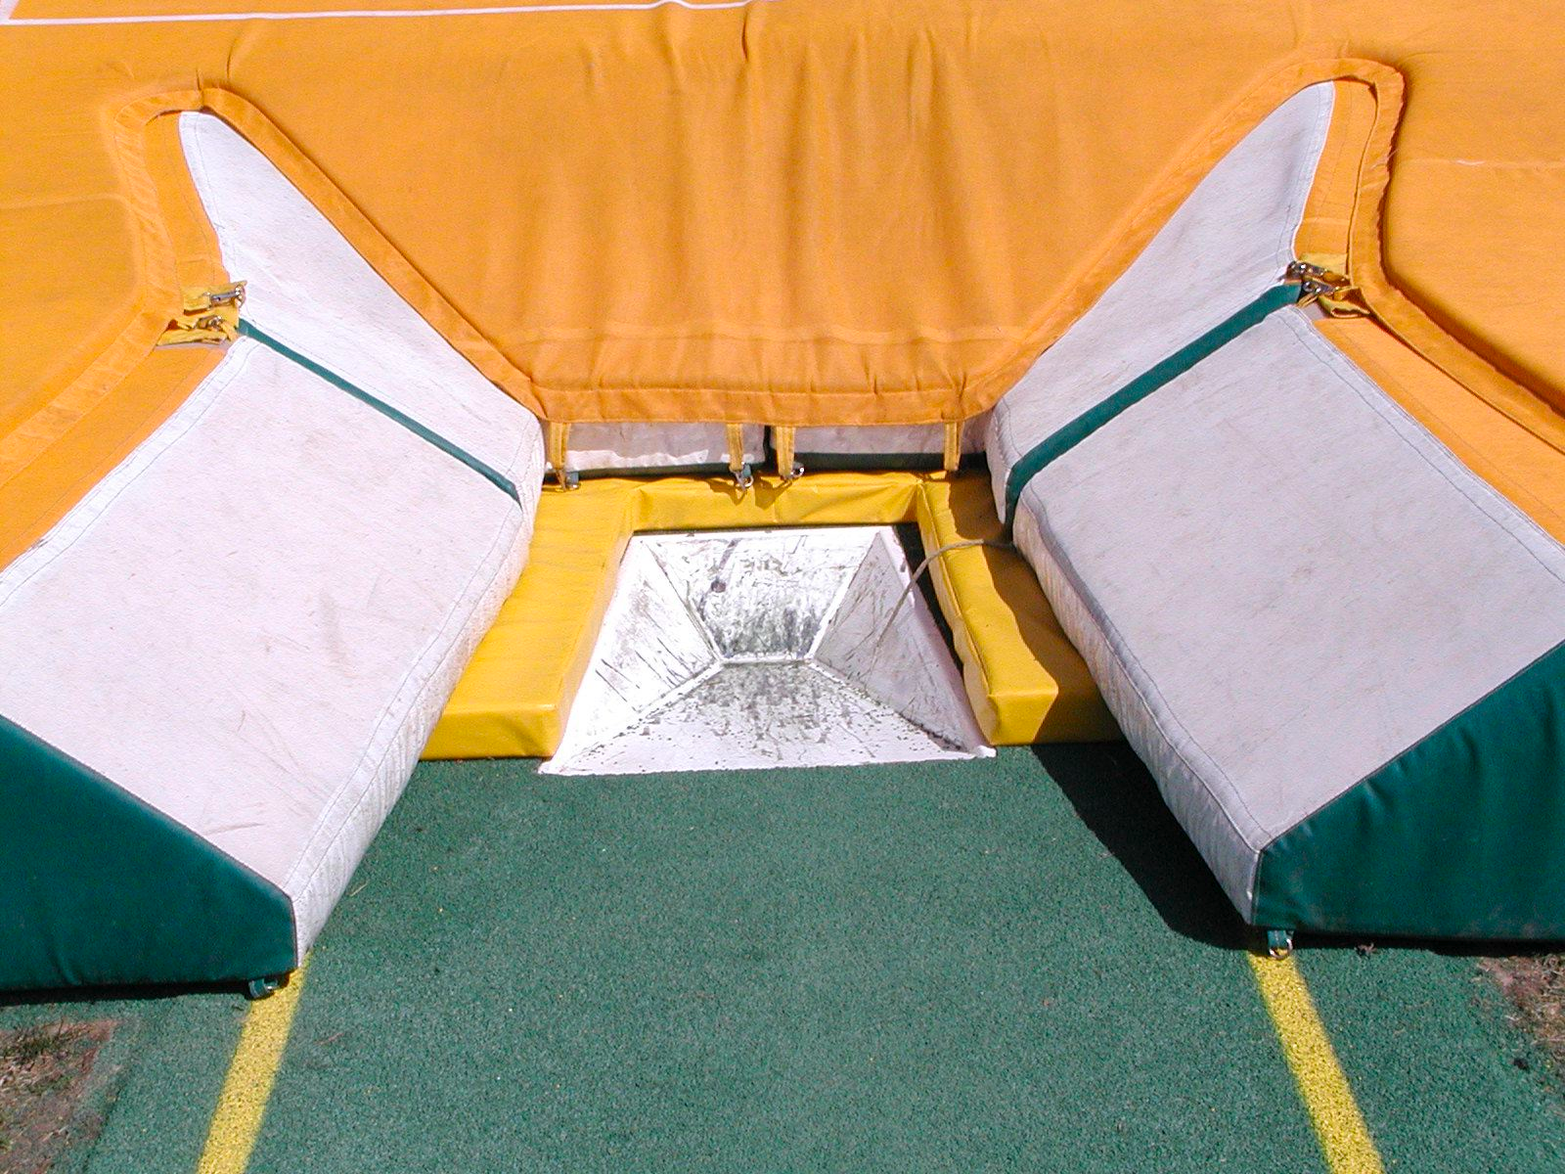
Good Pit - OLD Box Collar used to cover hard and unyielding areas between box and pit - NO LONGER LEGAL FOR HIGH SCHOOL COMPETITION

Slide 18
A Legally Installed New Box Collar

Slide 19
Box Collar
Padding meeting the ASTM Specification Standards shall be required for the start of the 2015 track season.
Rationale: For the purpose of minimizing risk of injury to a pole vaulter, require that planting box padding shall meet the applicable ASTM Specification Standard no later than the start of the 2014-15 track season. This required implementation date allows for product availability.

Slide 20
Gill - Box Collar

Slide 21
UCS – Box Collar

Slide 22
New Box Protectors
One major concern about the new box protector, is that it can move, and therefore impede the bend of the pole. Officials need to MAKE SURE that the “bend cavity” – the area near the back of the box which is cut out to allow the pole to bend – does not slide towards the pit and therefore not work!!!!

Slide 23
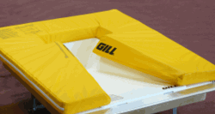
Bend Cavity
Bend
Cavity

Slide 25
Vaulters’ Poles are hitting the pit while bending
7.5.8/B - “If [a vaulter feels] the position of the landing pad would hinder the bend in his/her pole and the pad was not placed at its maximum distance from the stopboard, he/she should have made his/her wishes known prior to the beginning of the competition. In no case may the pit be moved farther than 3 inches from the stopboard, regardless of any hindrance this may cause to the vaulting pole.”
This rule does NOT mean the ASTM approved box protector can be removed!!! We need to make sure that it is in the proper place and doesn’t move

Slide 26
Stopping the Bend
If a pole strikes the pit as it bends - it will stop bending and either straighten out (causing the vaulter to “stall out” and not penetrate into the pit) or potentially break.
Poles can strike the pit because:
Pit is raised up on pallets - causing it to be too high and the pole doesn’t have the room to bend/swing
New ASTM approved Box Collar is not properly installed or has shifted due to use

Slide 27
Raising the Pit up on Pallets
If a pit is raised up too high (on pallets, tires or the like) it can restrict the bend of the pole, causing the pole to straighten out prematurely and the vaulter to come down in the box

Slide 28
Stopping the Bend
As an official there are limited things that can be done if the pit is impeding the bend
If the pit is raised - it can be lowered
If the pit is flush against the box, if can be pushed back (but only 3” and the resulting area exposed around the box must be padded
If there is room around the box, the vaulter can ask that the area be moved to one side (“I’ll take my 36” gap to the left please”)
- 2007-08 Rule - “FLAT BACKED” PITS (PITS WITH NO SLOPE FROM THE BOX TO THE TOP OF THE PIT) ARE NOW ILLEGAL!!!!!

Slide 29
Where is the Zero Point???
ZERO POINT DETERMINATION Page 59 Rules Book 7-5-13
“The zero point is at the top of the back of the planting box. It is used to determine the distance the crossbar travels toward the back of the landing surface, the starting point of the runway and to identify the proper placement of the landing surface.”

Slide 30
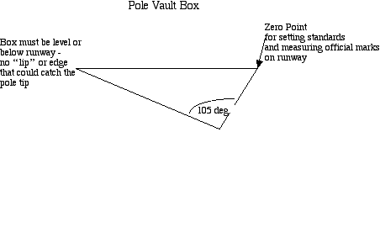

Slide 31
Check Marks
MEET MANAGEMENT CHECK MARKS
Page 60 Rules Book 7-5-20
“A mark or marker shall not be placed on the runway, but it is permissible to place markers at the side of the runway. Meet management may provide check marks, not more than three inches long, on the runway. Starting at the back of the planting box [zero mark], mark intervals in the following manner: 6’, 7’, 8’, 9’ 10’, 11’, 12’, 13’, 20’, 30’, 40’, 50’, 60’ 70’, 80’, 90’, 100’, 110’, 120’.”

Slide 32
Comment on Marks
Takeoff Marks are the single most important tool that athletes and coaches can use during competition to insure a safe vault.
Good preventative officiating is for the vault official to put down plant marks from 6’ to 13’ if they aren’t already there.
The placement of these marks by the official does NOT prevent the athlete from placing marks beside (not on) the runway (the Games Committee can determine the number of those marks)

Slide 33
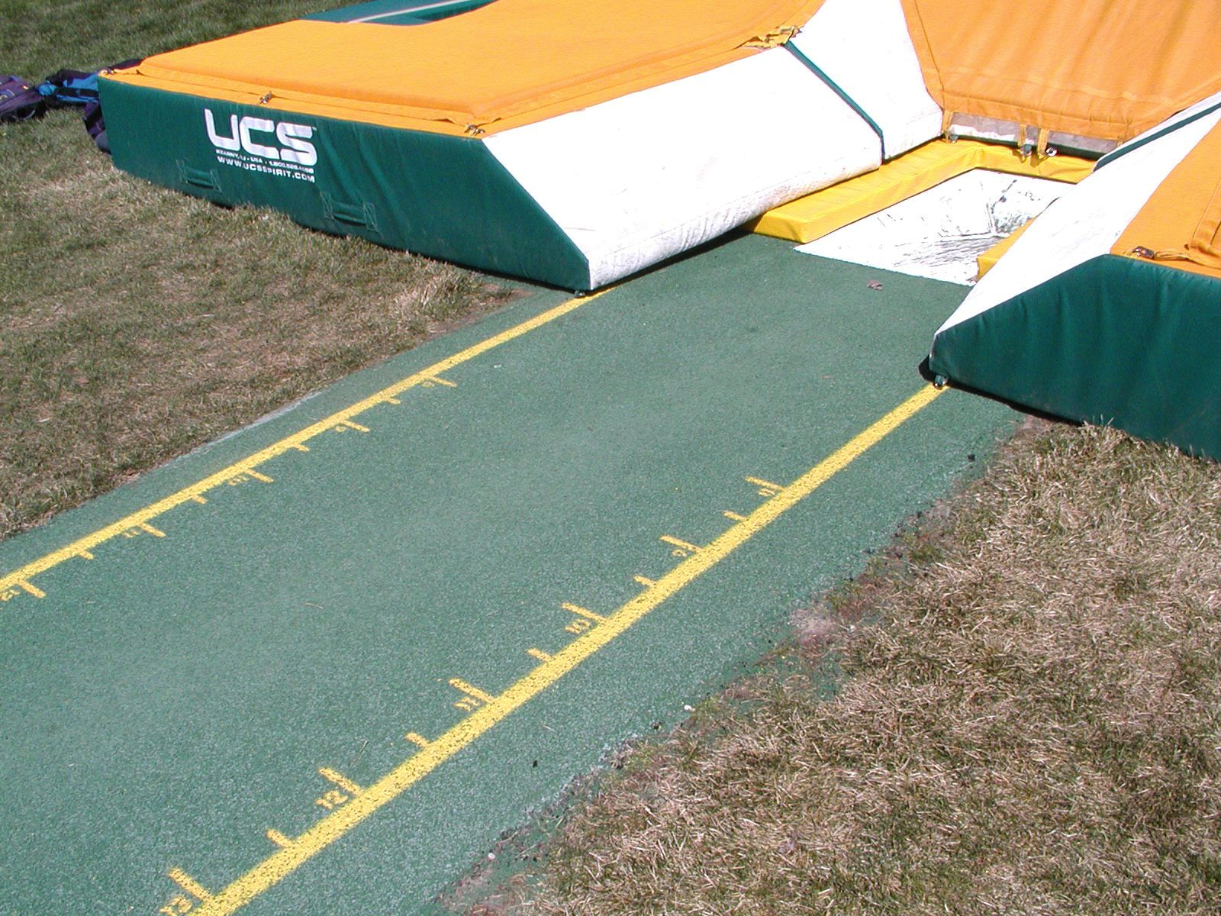

Slide 34
Standards
Standards (which hold up the crossbar) need to be able to move from 18” behind the zero mark to 31 1/2” (45cm to 80cm). They also need to be able to be “zeroed” for the purpose of measuring the crossbar. The “zero” mark is determined by extending the zero from the back of the box to the standard.
(behind the zero mark means towards the mat) *changed to 18” in fall of 2012

Slide 35
Standards
The deeper a vaulter jumps into the pit, the safer the vaulter is likely to be. Therefore it is critical that standards can be set the full range from 18” to 31 1/2” inches.
The measurement should be made from the position of the crossbar. Therefore the crossbar should be lined up (not some other part of the standard) at the appropriate mark when setting the standards.

Slide 36
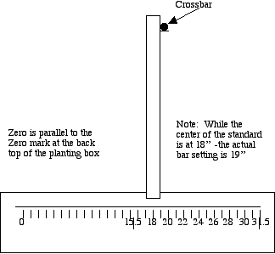

Slide 37
Section 2 - Poles and Pole Vaulter Inspection
The event official is responsible for inspecting the pole(s) and making sure they are appropriate (weight, legality) for the vaulter who is using them

Slide 38
Pole Inspection
POLE WEIGHT RATINGS
Page 56 Rules Book
7-5-3 “The competitor’s weight shall be at or below the manufacturer’s pole rating. The manufacturer must include on each pole: the pole rating that shall be a minimum of ¾” in a contrasting color located within or above the top handhold position; a 1-inch circular band indicating the maximum top handhold position with the position determined by the manufacturer. …

Slide 39
Pole Inspection
As of 2009 – National High School Federation rules state that reading the weight etched into the pole by the manufacturer is NOT a way to certify a pole. The pole must have the manufacturer’s label. In the past coaches could mark poles made prior to labeling to make them legal. As of 2009 - this is no longer allowed.
Note - coaches with poles manufactured prior to labeling (pre-’94) can check with the poles’ manufacturer about getting proper labels for those poles.

Slide 40
Pole Inspection
As the rule states that the Manufacturer’s Logo is placed determined by the Manufacturer -- it is important that Officials recognize when that label has been altered.
Athletes and coaches have altered the labels -- including those competing at the highest levels
- alterations include moving the label (higher on the pole) and changing the labels from one pole to another to make a pole appear to “weigh more”

Slide 41
Pole Inspection
Note: Poles are certified for a weight vaulting with the top hand holding at or below the handhold label. When that label is moved (up the pole) it actually lowers the effective weight rating of that pole (thus a 160 might really be a 157).
This creates an UNSAFE condition.

Slide 42
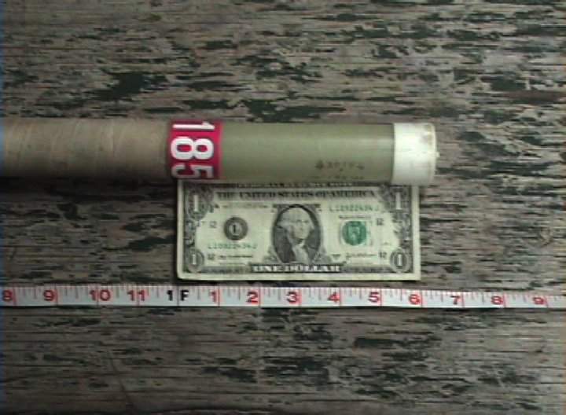

Slide 43
Pole Inspection
UCS Spirit Pole labels are placed by the manufacturer such that the bottom of the handhold label is six inches below the top of the pole.

Slide 44
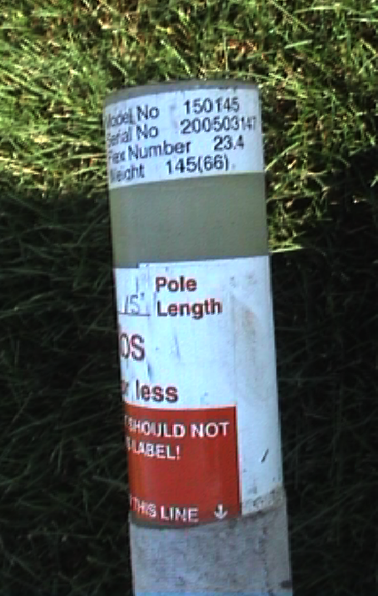
Poles Manufactured by Gill - Pacer, Skypole, Mystic
Hand hold mark 3” from top of pole - weight marked on handhold mark.
Also - flex# and weight on label on top of pole
Finally (on newer poles) a barcode label is actually in the pole - if there is a question the barcode label # should match the label# on the top of the pole (thus assuring the pole is rated as marked)

Slide 45
Essex Pole Label - 3” from top of pole Yellow label - pole marked in exact decimals (123.2 pounds).
Note - the top of this pole has been checked in too many times!!!!!

Slide 46
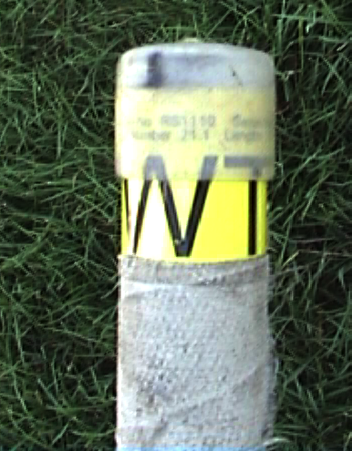
Newer Essex Label - also has flex information included on the top of the pole.

Slide 47
Training Poles
Variable weight or training poles are still around. They are weighted to a “range” (ex: 100-120) and ARE NOT ALLOWED IN HIGH SCHOOL OR USATF RULES COMPETITIONS.
Such poles are marked as “training” or marked with a weight range rather than a maximum vaulter weight

Slide 48
Pole Inspection
If the pole is altered - then it should be disallowed for competition. If there is a question about “relabeling” - then the pole should be disallowed.

Slide 49
Tape on the Pole
2011- National Federation rules of no more than 2 layers of tape has been CHANGED. USATF rules and National Federation are now the same.
The rule – no “number of layers” rule – simply that it must be smooth and of uniform thickness
In practice – poles should be taped from the lower end of the pole to the upper to avoid ridges. Taping from the top will be smooth at first, but ridges will appear in competition.

Slide 50
Tape on the Pole
7.5.21/B Use of Adhesive Materials Page 83 Case Book
A vaulter may use an adhesive spray on their hands and/or the gripping area of the pole.
A vaulter may use electrical tape or “a special vaulting grip tape which is sticky on both sides” as long as any ridges that occur do not “violate the rule restricting the binding and gripping of adhesive tape of uniform thickness, the taping will be ruled legal.”

Slide 51
Tape on the Pole

Slide 52
Vaulter Check-in
A typical vaulter check-in card would allow for the information needed and would create an easy “check-off” for each pole inspected
USATF Note – in non-youth USATF competitions there is NO pole label/weight requirement

Slide 53
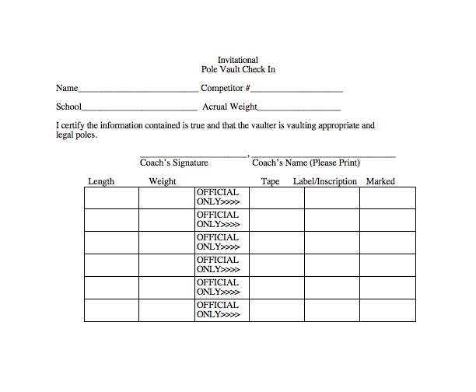

Slide 54
Number of Poles to Check In
Comment: Many officials are concerned with the number of poles a vaulter checks in. There is no “rule book” support for limiting the number of poles checked in. The rule does states that all poles should be checked in prior to competition (NFHS 7-5-5)Therefore, according to rule:
- a vaulter can check in as many poles as they wish
- a vaulter SHOULD check in ALL possible poles in
order to follow the appropriate rule

Slide 55
Question?
A vaulter:
Breaks a pole in competition, or
Weather conditions change dramatically.
Should the vaulter:
Be allowed to borrow a pole checked in by another competitor; or
Be allowed to check in an additional pole?
A reading of the rules (both USATF and National Federation) – that a vaulter could borrow a pole but NOT check in an additional pole

Slide 56
Section 3 Conduct of the Pole Vault
Officials should arrive one hour prior to the scheduled beginning of the event
Officials should check the venue and equipment prior to the beginning of warmups (see check list)

Slide 57
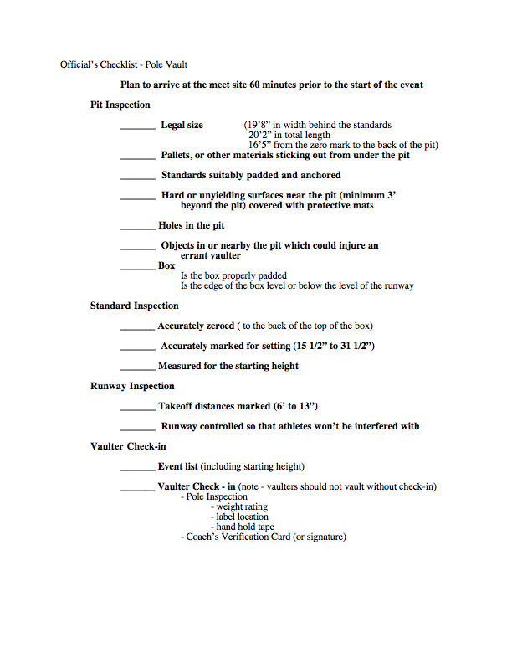
18-31.5

Slide 59
Pre Competition
As vaulters arrive, check-in and begin warmup activities, observe in order to make sure rules (vaulting of legal poles, not allowing assisted/spotted vaults).
Note - Vaulters may only use legally checked in and marked poles for warmup activities which involve jumping into the pit (7-2-9, 7-2-11)

Slide 60
Assisted Vaults
- Assisted vaults (often called “tapping” or spotting) when another pushes the vaulter on takeoff is not allowed at a competition site either in warmups or obviously in competition (7-2-10)
Drills that are not vaults (plant drills where the vaulter is spotted but IS NOT a vault attempt) ARE allowed

Slide 61
Pre Competition
Note - Warmup in the pole vault will require a minimum of 30 minutes for even a small field. Larger field may require longer warmup times in order to assure fairness and SAFETY (do NOT allow meet time pressures to compromise safety)
Remember - getting a step off in the long jump is a foul - but in the pole vault may cause a vaulter to be injured. Warmup is essentially a safety issue - as well as a competitive one

Slide 62
Pre-Competition
While checking in vaulters - get the following information:
Starting Height
Standard Setting
Remind vaulters that you will use the standard setting given to you unless they come and specifically change it - It is THEIR responsibility

Slide 63
Event Sheet
Should Include:
- Name/School
- Comp #
- Standard Setting
If Possible - enough
Room for every competitor - it makes it a lot
easier!!!!!!!!

Slide 64
Competition
Officials
1 - “Runs the Board”
2 - Calls “makes and misses”
3 - Sets and Checks Crossbar
Would call “volzing” and pole releases
Would make call if pole “rebounds” from box
collar
Also would check-supervise standard settings

Slide 65
Competition
Workers
2 workers - set crossbars and set standards

Slide 66
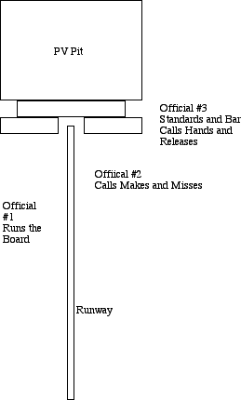
Positions
Official 1 - midway down the Runway
Official 2 - In position to see back of box and bar clearance
Official 3 - In position to see pole release and bar clearance (hands on bar)

Slide 67
Competition
Official #1 - Running The Board
In competitions where there are more than 10 vaulters at a given height - the vault should be conducted using “5 Alive”
The idea of “5 Alive” is that each vaulter will have no more than 5 vaults between their attempts (allowing them to stay warmed up while still getting some rest time between attempts)

Slide 68
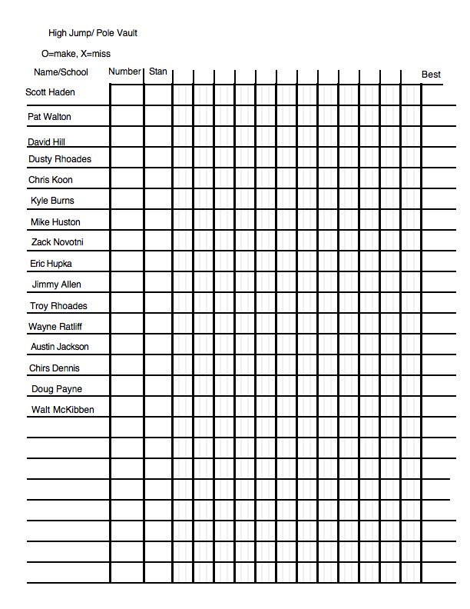
5 ALIVE!!!!!
1st 5 vaulters straight thru
(Haden - Koon)
If all clear - continue down list
If one misses - vault 5 more - then back to the miss
Continue down the list - but - make sure you don’t “hang” the last vaulter - if you have to go six or seven alive to pick him up - do it!!!!!

Slide 69
Haden O
Walton O
Hill X
D Rhoades X
Koon O
Burns O
Huston X
Hill X X
D Rhoades XO
Novotni O
Hupka X
Huston XO
Hill XXO
Allen X
T Rhoades P
Ratliff X
Jackson O
Hupka XX
Dennis O
Payne O
McKibben X
Hupka XXX
Allen XX
Ratliff XX
McKibben X0
Allen XXO
Ratliff XXO

Slide 70
5 Alive
Items to consider
Make sure athletes are clear about the order (up, on deck, on hold, waiting)
This is why the primary job of Official #1 is to run the board - if you’re calling makes and misses at the same time it gets to be too much
Avoid making vaulters take multiple attempts in a row if at all possible
Watch for the last couple of vaulters as you move through the list - don’t leave them “hanging”

Slide 71
Efficiency in Running the Vault
Standard settings should be marked on the board
Competitors should be instructed to make setting changes prior to be called up
If they don’t - then it’s on their time!!!

Slide 72
Efficiency in the Vault
Calls would sound like this:
“Haden up - Standards at 24”
“Walton on deck”
“Hill on hold”
“D Rhoades waiting”
After Haden is called - the standards are set

Slide 73
Efficiency in the Vault
Vaulters have 1:00 to vault after the standards have been set. Judge #3 should signal that they are ready
“Standards are set”
The rule states that the vaulter must initiate an attempt that goes to completion within 1 minute (new in 2014). Therefore, as long as they start down the runway on a vault that is completed - it is a good vault.
If however, they stop and go back after the time expires, or do not start prior to the expiration of time - then it is a miss.

Slide 74
Time Limits in the Vault
Vaulters have 1 minute from the time the standards are set to initiate a vault to completion. (USATF – 1:00)
When there are 3 or fewer vaulters, that time period is 3 minutes(USATF – 3:00)
When a single vaulters is left that time period is 5 minutes (USATF – 5:00)
If a vaulter has consecutive trials – 3:00

Slide 75
Warmup
- After an athlete has passed three heights and at the height the athlete intends to enter the competition the athlete will be given 2 minutes for warmup before the start of that height.
If multiple athletes are entering the competition their 2 minutes are added together - ex: 5 athletes - 10 minutes
note: there has been an interpretation that this means 2 mins for each individually on the runway. The rule book states “…2 minutes of warmup jumps per the number of competitors entering at that height…”
It makes no mention of each individual taking their two minutes therefore five competitors equals 10 miniutes – regardless of whether
They choose to use it all or not

Slide 76
USATF Warmup Rule
In USATF competitions vaulters are allowed one warmup vault for each three consecutive passes. However, they must take the warmup vaults “as earned” not cumulatively.
Pass 3 heights – take the jump
Pass 3 more – take another
Pass 6 heights – only get ONE jump!!

Slide 77
Section 4 Competition Rules and Practices

Slide 78
Making the Call - Vault or No
It is primarily Official #2’s job to determine whether an attempt occurs.
An attempt occurs when the vaulter
Touches any part of the pit with body or pole beyond the “zero” mark
Time expires without initiating an attempt to completion (#2 runs the clock)

Slide 79
What is an attempt?
Under National Federation Rules
An attempt is when a vaulter leaves the ground in an attempt to clear the bar (a jump) NOTE : whether a vaulter “made an attempt” or simply came to a “jump stop” is an official judgment call; or
When a vaulter’s body or pole touches any part of the pit or runway beyond the “zero” mark
Under USATF Rules
An attempt is when a vaulter’s body or pole touches any part of the pit or runway beyond the “zero” mark
(the difference – a vaulter could jump – stall, land on the runway and still NOT have made an attempt in USATF)

Slide 80
What If the vaulter…
comes down the runway, then at the last minute puts his pole in the box and stops
stops, and both feet leave the ground in what clearly IS NOT an attempt to jump
does not put the pole in the box, but misses the box and hits the pit beyond the “zero mark”
Drops the pole and runs into the pit beyond the zero mark
Drops the pole and runs onto the front bun, but does NOT go beyond the zero mark
Puts the pole in the box and jumps, but does not touch any part of the pit beyond the zero mark, landing back on the runway
Does not put the pole in the box, but holds it up, over the pit (and beyond the zero mark) but DOES NOT touch any part of the pit beyond the zero mark

Slide 81
The Answers!!!
1. As long as time has not expired – NO ATTEMPT
2. As long as time has not expired – NO ATTEMPT
3. COUNTS AS AN ATTEMPT
4. COUNTS AS AN ATTEMPT
5. As long as time has not expired – NO ATTEMPT
6. National Federation – COUNTS AS AN ATTEMPT
USATF – NO ATTEMPT
7. As long as time has not expited – NO ATTEMPT

Slide 82
Official #2
You are the primary event official - you are making the call on the vault. Make sure you pay attention to the complete vault, until it is clear that all actions (pole falling away from the bar, bar shaking, etc) are finished. Then clearly make the call - Good Vault or Miss. Flags help determine this for the crowd.

Slide 83
Official #3 - needs to make the call:
Vaulter is gripping above the handhold band
(may grip on the band - but the top of the band must be visible)
Vaulter vaults on pole NOT checked in or inspected
Vaulter “regrips” higher on the pole with top hand after leaving the ground

Slide 84
Calls on “the bar”
“Volzing” is the vaulter steadying the bar with his hands during the attempt. If the vaulter touches the bar with a hand or arm in an attempt to steady it, it should be a failed attempt.
The biggest call Official #3 will need to make is the “properly released pole”

Slide 85
What if the pole…
1. Falls into the bar - knocking it off, and the vaulter made no effort to push it back
2. Falls into the bar - knocking it off, after the vaulter pushed it away and it traveled back to vertical, then fell back to the bar
3. Goes under the bar, either hitting on not hitting the standard - but not dislodging the bar
4. Comes to rest on the crossbar, and the crossbar stays up
5. The vaulter clears the bar, then jumps up and catches the pole that is about to hit the crossbar

Slide 86
The Answers!!
Failed Attempt
2. Official Judgment call – but - should
be a good vault
3. Good vault
4. Good vault
5. Failed Attempt (clarified in 2012)

Slide 87
Calls on the “bar”
There seems to be controversy about the “pole resting on the crossbar” scenario. It is up to the official to determine whether the vault has concluded and the bar is “up”. If the official calls a “good vault”, then the location of the pole no longer matters. Taking a resting pole off of a steady crossbar IS NOT part of the vaulting attempt. Who “takes it off” the bar makes no difference. If there is a question as to whether the pole will knock the bar off -- wait to make the call!!!!!

Slide 88
The Falling Pole
Once a vaulter has released the pole - the pole cannot be interfered with by anyone - including the VAULTER - until it comes to rest. A vaulter who comes out of the pit to “save” a falling pole from hitting the crossbar should receive a “miss”.

Slide 89
An Ancient Tale
When Spiritus, noted Athenian vaulter, cleared the bar in the pole vault and landed in the sand, the bar continued to shake. Spiritus leapt from the sand and sprinted out, claiming that he was clear of the pit prior to the bar falling off.
Wise Officius made the call, saying that even in these ancient times it didn’t matter where Spiritus was when the bar fell. “If he caused the bar to fall, it was in fact a “miss”” spake the sage.
Nothing has changed since Spiritus and Officius -- it doesn’t matter where the vaulter is (in or out of the pit), if they caused the bar to fall, they get the “miss”.

Slide 90
Calls on the Bar
For a good vault - the bar must not be displaced from the pegs upon which it originally rested
Therefore - if the bar is not on the pegs where it started - it is a failed attempt
IF there is an equipment failure during the vault (ex: standards slip) it IS a “no vault”
and the athlete gets a “do-over”

Slide 91
Falling Crossbar
7-2-11: A crossbar displaced by a force disassociated with the competitor after he/she is legally and clearly over the crossbar shall not be a fault.
Rationale: Addresses possible influence of an outside force on the crossbar on an otherwise successful attempt.
Note – wind forces would be the most obvious reason

Slide 92
One more crossbar scenario
Here’s a complication that’s going to happen with the new ASTM box collar.
The pole is properly released, but catches on the box collar and rebounds into the crossbar.
The “call”?? If the official saw that the pole was properly released, then it should be a good vault. That’s why the official calling the vault needs to watch all of the action through to the conclusion

Slide 93
Summary of Officials Duties
Official 1 - Runs the board, marks makes and misses - keeps and calls out standard settings
Official 2 - Makes call on Makes and Misses, also looks for aborted jump attempts, keeps time on attempts
Official 3 - Watches handgrip on pole, and along with Official 2, makes calls on volzing, makes call on proper release, determines that standards are set correctly.

Slide 94
Setting and Measuring the Bar
The standards height and zero should have been set prior to warmup. Officials should measure at the starting height, at each change of height, and any time the standards may have changed (standard might drop due to improper tightening).
In non-championship competition, bar height might be measured less frequently but should still be done several times during the competition to insure accuracy

Slide 95
Measuring the Bar Height
To accurately measure the bar, the standards should be moved to the “zero” setting, and the bar should be measured from the top of the back of the box (actual “zero”) to the top of the middle of the crossbar.
Accurate measuring - use a measuring bar
Use a measuring tape and ladder (slow!!!)
Use a measuring tape doubled back to the box
Hold the tape zero at the box, then put the measuring tape over the bar and back to the box, subtracting for the diameter of the bar (approx 1”)
When a vaulter has won the event - they can choose the height (over the current height) they would like to attempt

Slide 96
Athlete Check-Out
Athletes should check out for limited periods of time ONLY
Allow athletes that need to check out to take their vaults out of order at a height (but remember, you cannot lower a bar within the competition, so they can only vault at the height now being contested)
Remind them - meet management can establish a time limit for them to be gone, after which they will be passed and the bar moved up (often - 10 minutes)
It is ultimately the coach’s responsibility not to spread athletes too thin. DO NOT PUT OTHER ATHLETES AT A DISADVANTAGE BY WAITING AN EXTRAORDINARY AMOUNT OF TIME - PASS THEM TO THE NEXT HEIGHT AND MOVE ON

Slide 97
Dual or Small Meets
Running a double bar - Open Pit Pole Vault
Start the boys and girls competition at the same time - boys 2’ higher than the girls (8’ for boys, 6’ for girls) without changing the standards, just moving to higher pegs.
Since this constitutes TWO competitions, as long as you don’t lower the bar within the boys or girls you CAN do the following:
Vault boys at 8’. If some have checked out to other events, vault girls at 6’. When the boys come back, move the bar back to 8’. When it’s time to move the bar up 6”, the heights are now 8-6 and 6-6. Keep vaulting at either height!!!!

Slide 98
The Double Bar
This will allow for more continuous vaulting and less waiting for checked out athletes. It also reduces warmup time (no need for two warmup periods)
Do make sure you take care of the better vaulters, maybe allowing an extra warmup period when the bar gets to 11-0 for boys and 9-0 for girls for those not yet entered in the competition (I take a 10 minute break)
Remember - you are NOT lowering the bar within a competition - the BOYS bar is always going up, and so is the GIRLS bar!!!!

Slide 99
Breaking Ties
When two or more vaulters are tied at a height:
The one who took the fewest attempts at the tied height wins
If a tie still remains
The one with the fewest total misses throughout the competition wins
If a tie remains - for any height other than first - it is a tie
First Place - Jump Off

Slide 100
Breaking Ties
Name 13-0 13-6 14-0 14-6
Walton O XO XXO XXX
Hill XO O XO XXX
Haden XXO XO XO XXX
Ratliff O O XXO XXX
Breaking the ties
Hill and Haden beat Walton and Ratliff on misses at last cleared height
Hill has two total misses, Haden has four
Hill wins, Haden second
Walton has three total misses, Ratliff two,
Ratliff is third, Walton is fourth

Slide 101
Vaulting Off for First
Name 14-0 14-4 14-8 15-0 15-0 14-9 14-6
Burns O XO O XXX X X X
Chia XO O O XXX X X O
Burns and Chia both cleared 14-8 on the first attempt. Both had one total miss in the competition. Vault off is by 3” increments, regardless of the increments going up. Both missed an additional attempt at 15-0, and 14-9. Chia cleared 14-6 to win the vault-off.
Winning Height - 14-8

Slide 102
Vaulting Off for First
Name 14-0 14-4 14-8 15-0 15-0 15-3 15-0
Burns O XO O XXX O X X
Chia XO O O XXX O X O
Burns and Chia both cleared 14-8 on the first attempt and had one miss on the competition. Both cleared 15 on the 4th attempts (first attempts in the vault off). Both missed at 15-3, so the bar goes back to 15-0, where Chia cleared to win. Winning height - 15-0.

Slide 103
Who is the Event Winner?
As always - the winning vaulter is allowed to select at what height he/she will attempt. The Rule Change clarifies that the last vaulter MUST BE THE EVENT WINNER.
Example -
10 10-6 11-0 11-3 11-6
Sue 0 X0 X0 P
Ann 0 0 X0 XXX
While Sue is the last vaulter remaining - she must vault the next increment as selected by the games committee - as she is NOT the event winner (if she fails to clear)

Slide 104
Who is the Event Winner?
Example -
10 10-6 11-0 11-3 11-6
Sue 0 X0 X0 P O
Ann 0 X0 0 XXX
At this point Sue IS the winner - and can set the bar at any height over 11-6 for her next attempt

Slide 105
Questions and Information
Pole Vault Information is available at:
www.watkinstrack.org
www.nfhs.org
Questions - email – mdahlman@watkinstrack.org

Slide 106
Questions and Information
Special Thanks to:
Ohio Track Coaches Association
Rob Wahl - PV Safety Chairman, Pennsylvania
Mark Hannay - Northeast Chairman, USATF PV Development Committee
Watkins Vaulters for having brought up and experienced almost every possible rule question in the past 35 years

